Slide 1
Classifying Life
The world of Biodiversity

Slide 2
Greek and Latin Prefix and Suffix Challenge
List 5 words using Greek/Latin prefix
List 5 words using Greek/Latin suffix
List 5 words that use a prefix and suffix together

Slide 3
How do biologists group and name organisms?

Slide 4
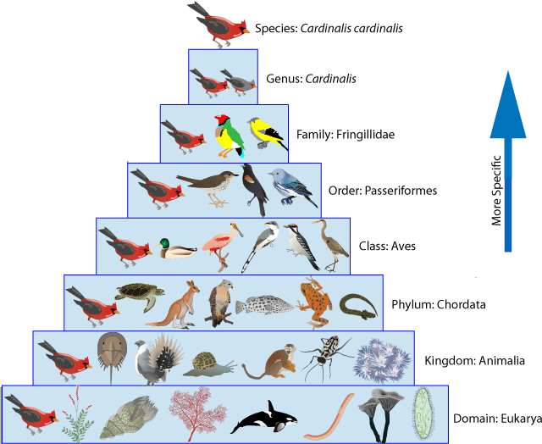
Taxonomy:
The science of naming, identifying and classifying species
Follows well-defined rules that describe how to properly name and classify any species

Slide 5
Taxonomy:
Taxonomy serves 2 purposes:
1) Identifying individual organisms
2) Representing relationships among organisms

Slide 6
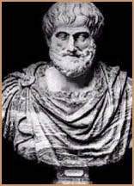
History of Classification
Aristotle
arranged organisms according to where they lived (air, water, land)
Aristotle (384 – 322 B.C.)
Notes:
What about birds?

Slide 7
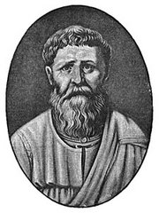
History of Classification
St. Augustine
classified organisms as useful, or harmful
St. Augustine (354 – 480 A.D.)
Notes:
This is where it’s at! You can either use it, or it can hurt you, or who gives a crap!

Slide 8
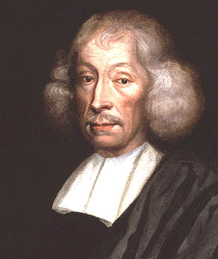
History of Classification
John Ray
Catalogued organisms based on shape, structure and whether they reproduced with each other
First to use word species
Listed 19 000 species of birds, fish and mammals
Notes:
This is where it’s at! You can either use it, or it can hurt you, or who gives a crap!

Slide 9
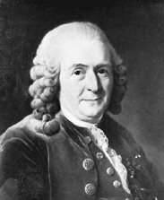
History of Classification
Carolus Linnaeus
Swedish botanist
developed modern system of naming organisms according to their physical characteristics
System referred to as binomial nomenclature
Linnaeus (1707 – 1778)

Slide 10
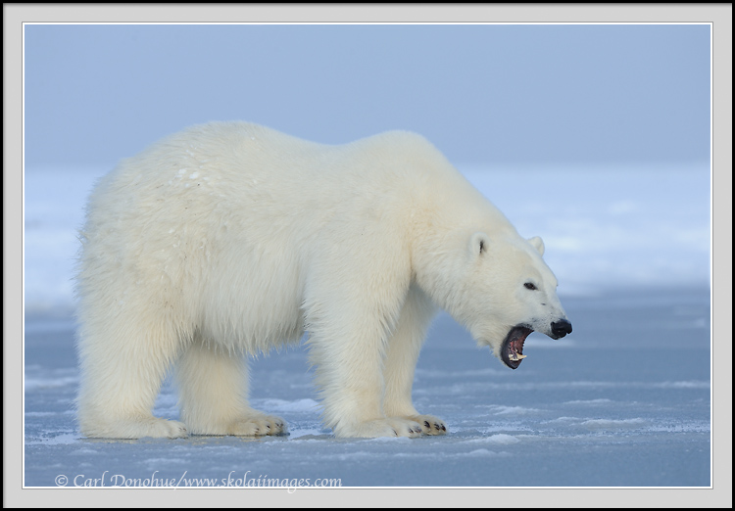
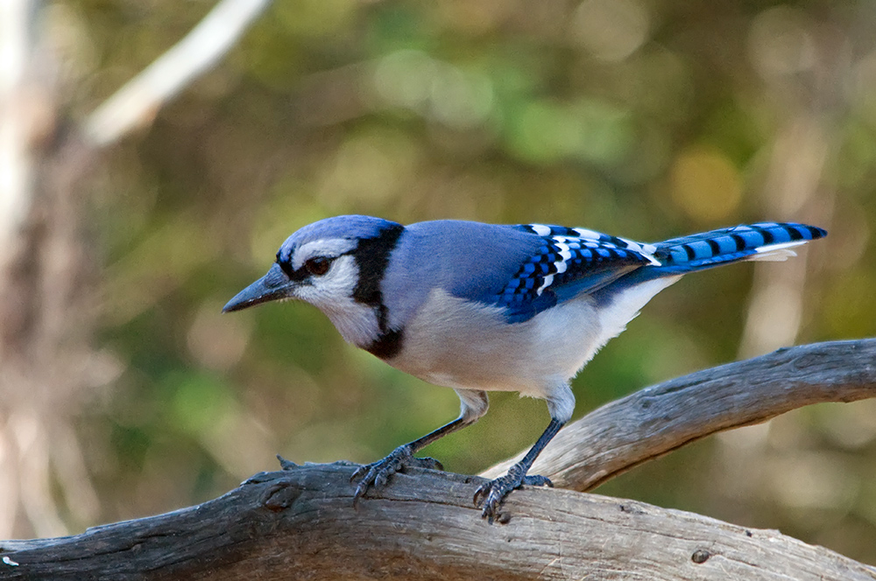
Binomial Nomenclature
Binomial means “two parts” and nomenclature means “naming system”
In this system each species has a two part name
Ursus maritimus
Erithacus migratorius

Slide 11
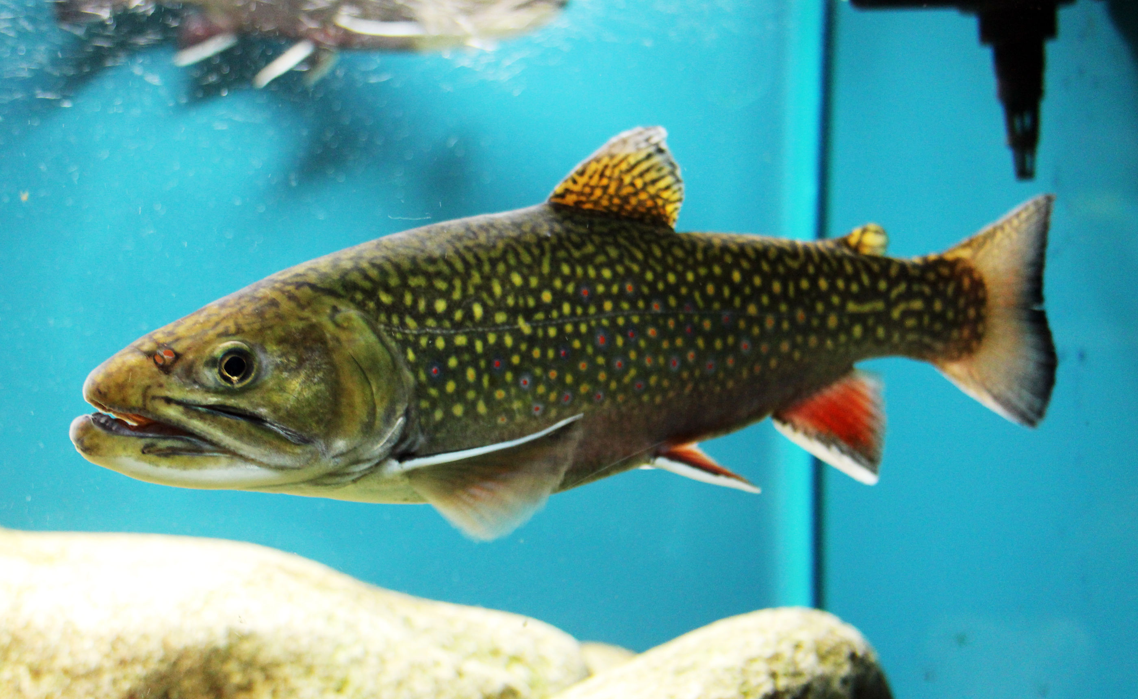
Binomial Nomenclature
Brook Trout (common name)
Salvelinus fontinalis (scientific name)
Typed in Italics
If hand written, words are underline
1st Word= Genus (capitalized)
2nd Word = Species (all lower case)

Slide 12
Taxonomy Name Challenge

Slide 13
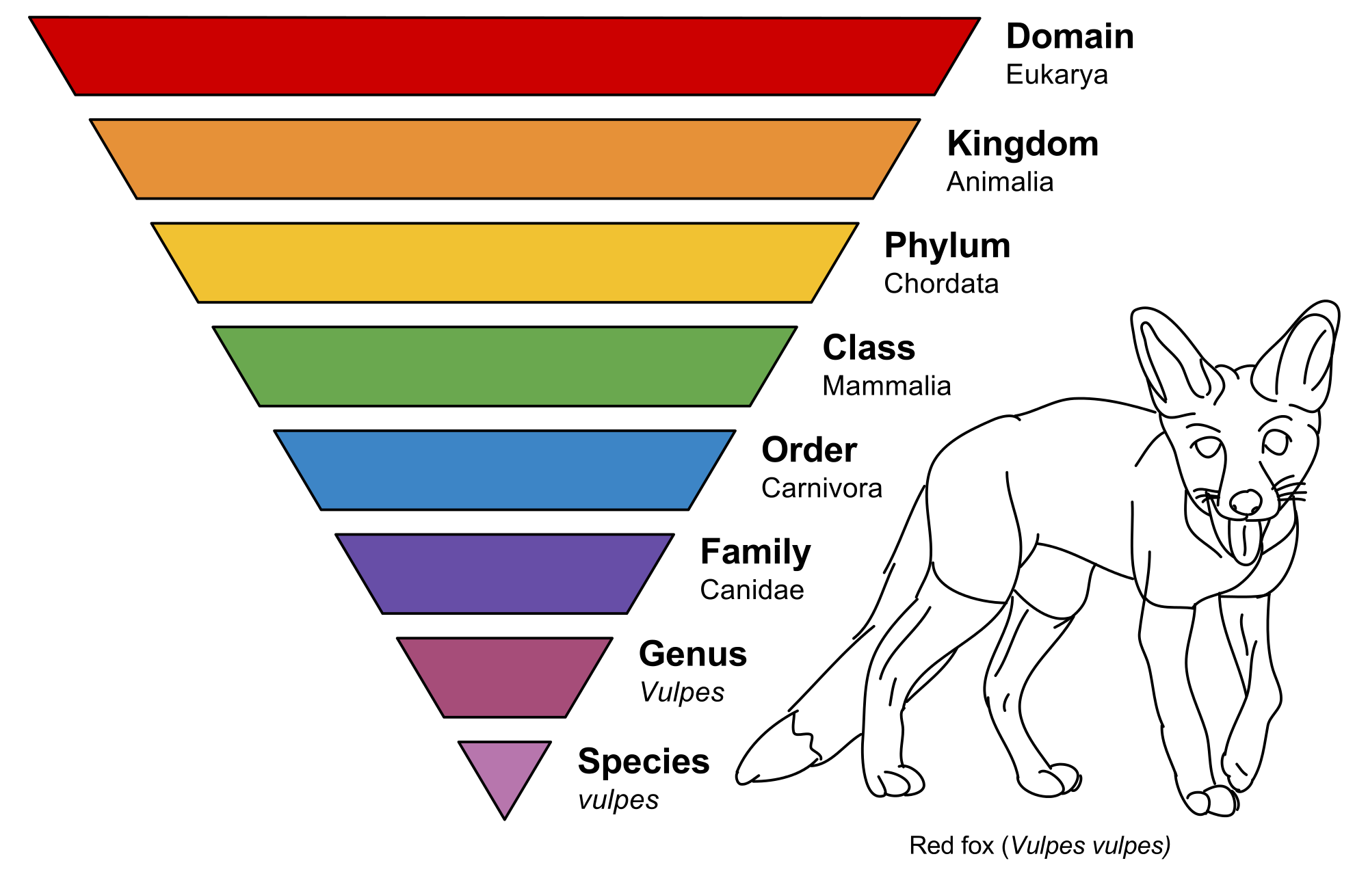
Our Current Classification System
In additional to binomial nomenclature, Linnaeus’ system grouped species into broader categories
Linnaeus created 8 categories
Each category referred
to as a taxon

Slide 14
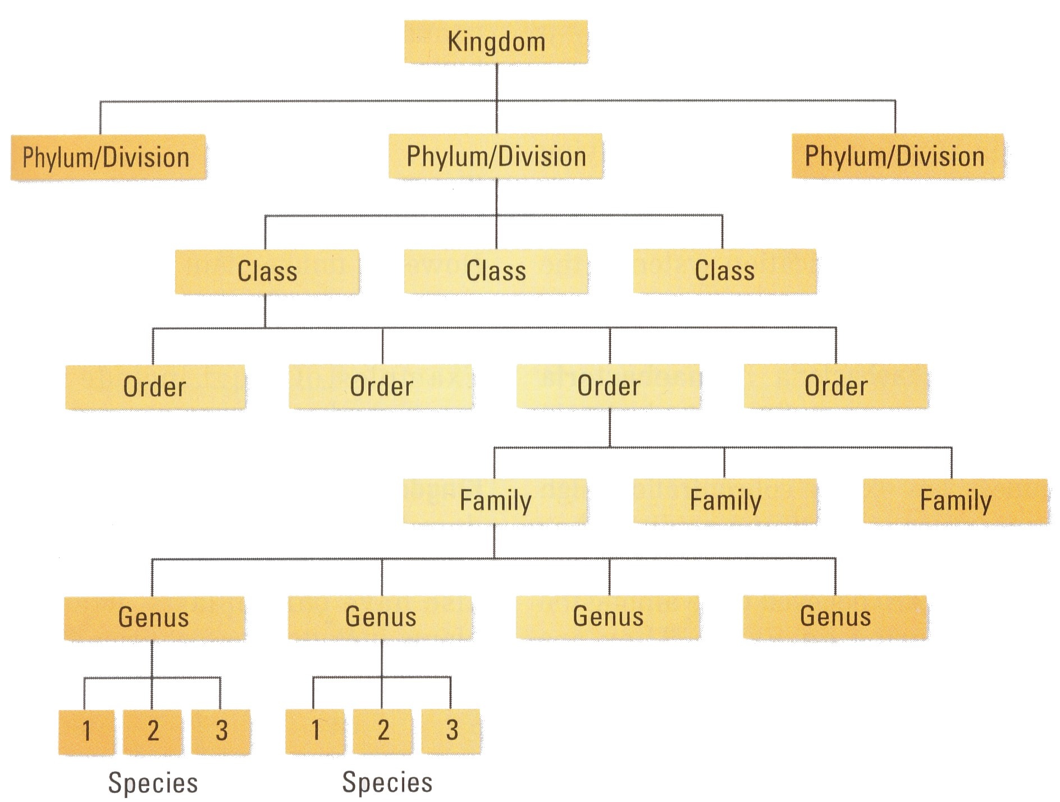
Taxonomy
Domain
Kingdom
Phylum
Class (Subclass)
Order (Suborder)
Family
Genus
Species

Slide 15
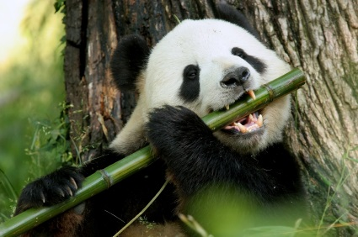
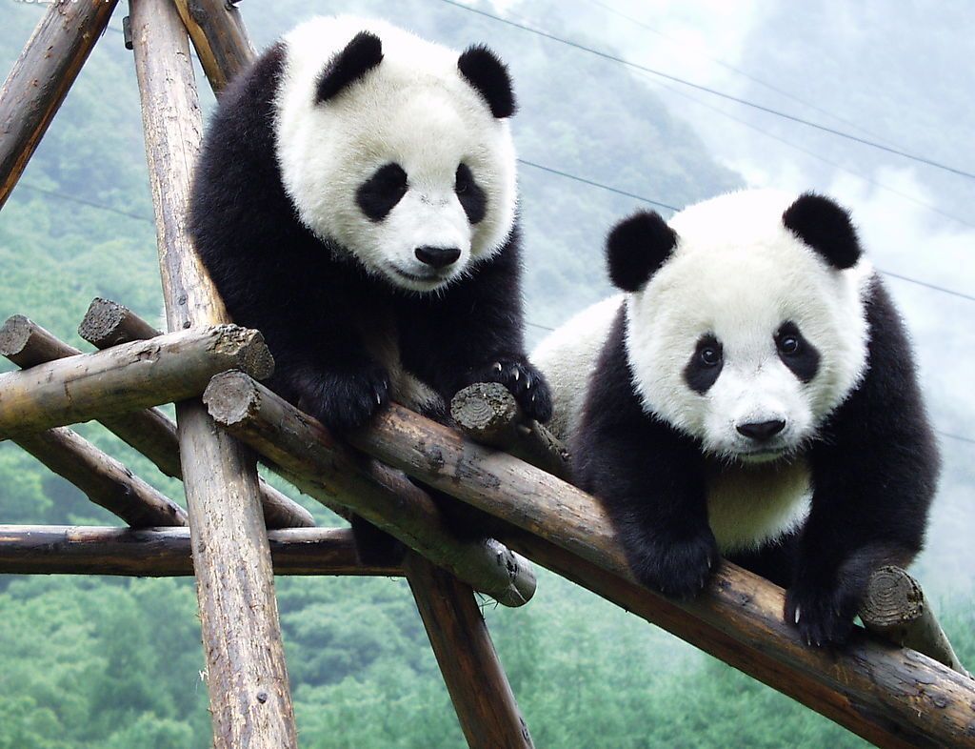
Taxon Levels: Giant Pana
Domain: Eukarya (Eukaryote)
Kingdom: Animalia (Animal, multicellular organism that is a heterotroph)
Phylum: Chordata (Has dorsal, hollow nerve cord)
Class: Mammalia (Mammal, feed young with milk from mammary glands)
Order: Carnivora (Have large canine teeth, shearing molars, and well developed claws)
Family: Ursidae (Bear, large mammal)
Genus: Ailuropoda (The Giant Panda)
Species: melanoleuca (Black and White Cat-foot)

Slide 16
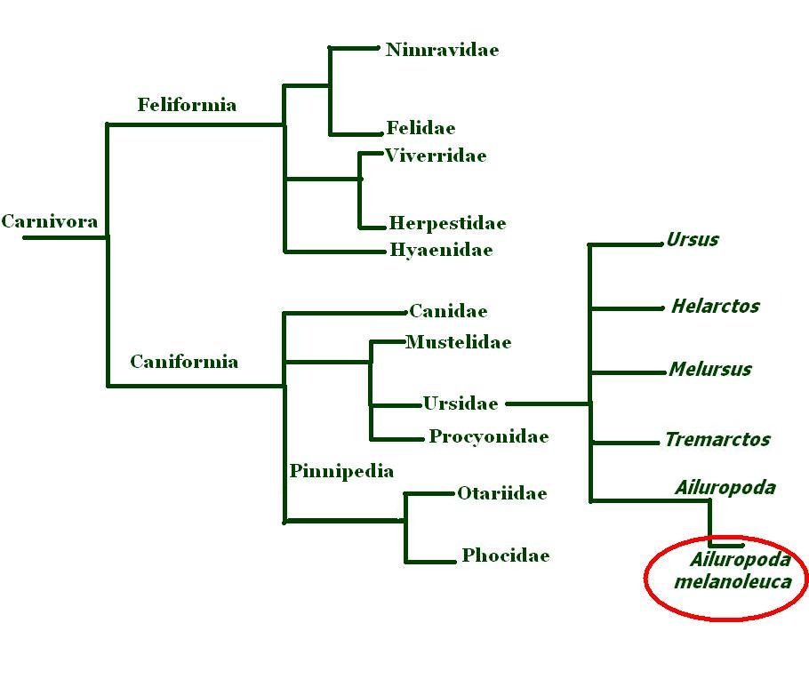
Giant Panda Taxonomy Tree

Slide 17
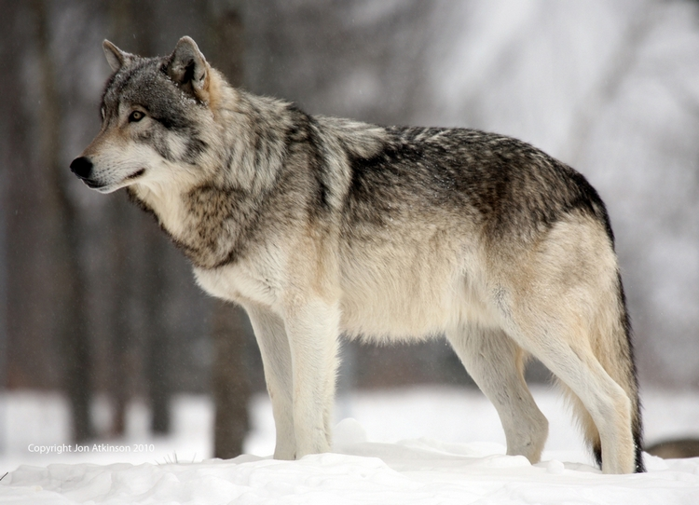
Grey Wolf
Taxon | Grey Wolf Taxon | Number of Species in Taxon
Domain | Eukarya | 4-10 million
Kingdom | Animalia | 2 million
Phylum | Chordata | 50 000
Class | Mammalia | 5 000
Order | Carnivora | 270
Family | Canidae | 34
Genus | Canis | 7
Species | lupus | 1
Canis lupus

Slide 18
Taxon | Human | Walrus | Bald eagle | Honey bee
Kingdom | Animalia | Animalia | Animalia | Animalia
Phylum | Chordata | Chordata | Chordata | Anthropoda
Class | Mammalia | Mammalia | Aves | Insecta
Order | Primates | Carnivora | Accipitriformes | Hymenoptera
Family | Hominidae | Odobenidae | Accipitridae | Apidae
Genus | Homo | Odobenus | Haliaeetus | Apis
Species | sapiens | rosmarus | leucocephalus | mellifera

Slide 19
Which organism is least closely related to the other organisms? Explain why.

Slide 20
Taxon | Human | Walrus | Bald eagle | Honey bee
Kingdom | Animalia | Animalia | Animalia | Animalia
Phylum | Chordata | Chordata | Chordata | Anthropoda
Class | Mammalia | Mammalia | Aves | Insecta
Order | Primates | Carnivora | Accipitriformes | Hymenoptera
Family | Hominidae | Odobenidae | Accipitridae | Apidae
Genus | Homo | Odobenus | Haliaeetus | Apis
Species | sapiens | rosmarus | leucocephalus | mellifera

Slide 21
Which organisms are most closely related? Explain why.

Slide 22
Taxon | Human | Walrus | Bald eagle | Honey bee
Kingdom | Animalia | Animalia | Animalia | Animalia
Phylum | Chordata | Chordata | Chordata | Anthropoda
Class | Mammalia | Mammalia | Aves | Insecta
Order | Primates | Carnivora | Accipitriformes | Hymenoptera
Family | Hominidae | Odobenidae | Accipitridae | Apidae
Genus | Homo | Odobenus | Haliaeetus | Apis
Species | sapiens | rosmarus | leucocephalus | mellifera

