Slide 1
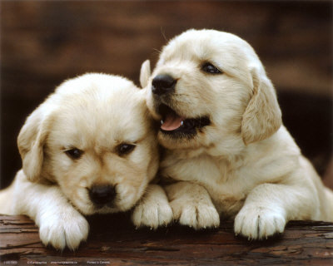
Biodiversity:
Identifying Species & Dichotomous Keys

Slide 2
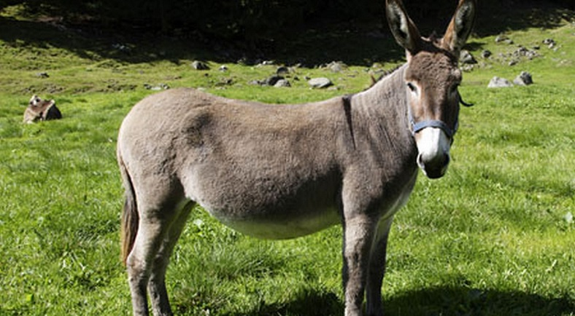
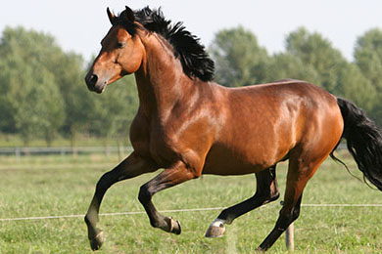
Why are donkeys and horses considered different species?
Donkey (Equus africanus asinus) Horse (Equus caballus)

Slide 3
Species by Definition
A group of organisms that can interbreed in nature and produce fertile offspring
2 million species have been identified
Scientist believe there are between 5-100 million species on Earth
Scientist cannot agree on one single definition for species, so they have created various definition called species concepts

Slide 4
Species Concepts
3 main concepts
  1. Morphological Species Concept (structure)
  2. Biological Species Concept (breed successfully)
  3. Phylogenetic Species Concept (evolutionary history and relationships)

Slide 5
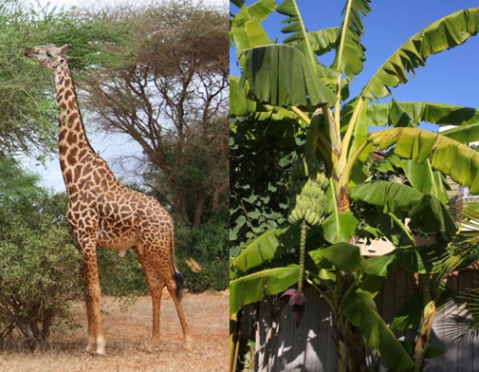
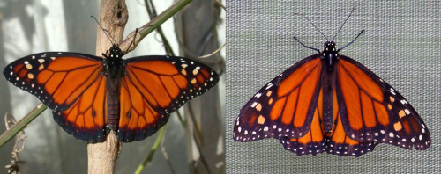
1. Morphological Species Concept
Focuses on morphology of an object
  Morphology: structure or form of an object
Relies on comparing measurements and descriptions of similar organisms
Takes into account that species change over time and that they have variation

Slide 6
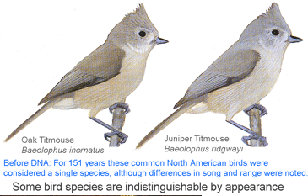
Disadvantages to this method?

Slide 7
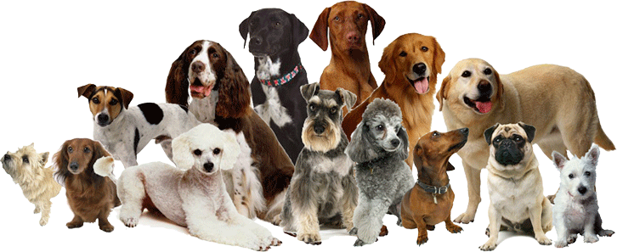
2. Biological Species Concept
Focuses on similar characteristics and the ability of organisms to interbreed in nature and produce viable, fertile offspring

Slide 8
3. Phylogenetic Species Concept
Focuses on the evolutionary relationships among organisms
  Phylogeny refers to the evolutionary history of an organism
A species is a cluster of organisms that is distinct from other clusters and shows a pattern of relationships among organisms
A diagram that shows these relationships is called a phylogenetic tree

Slide 9
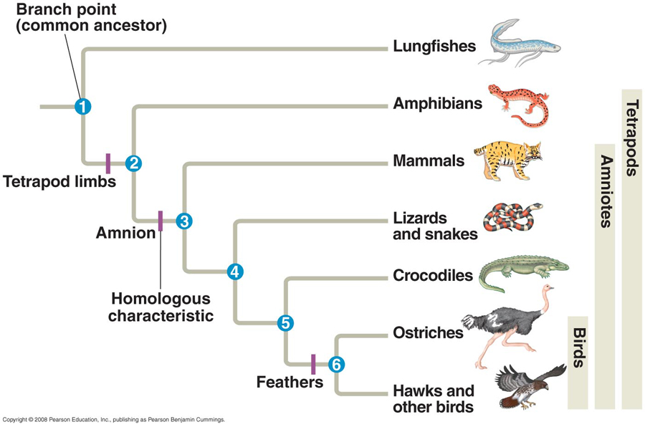
Phylogenetic Tree

Slide 10
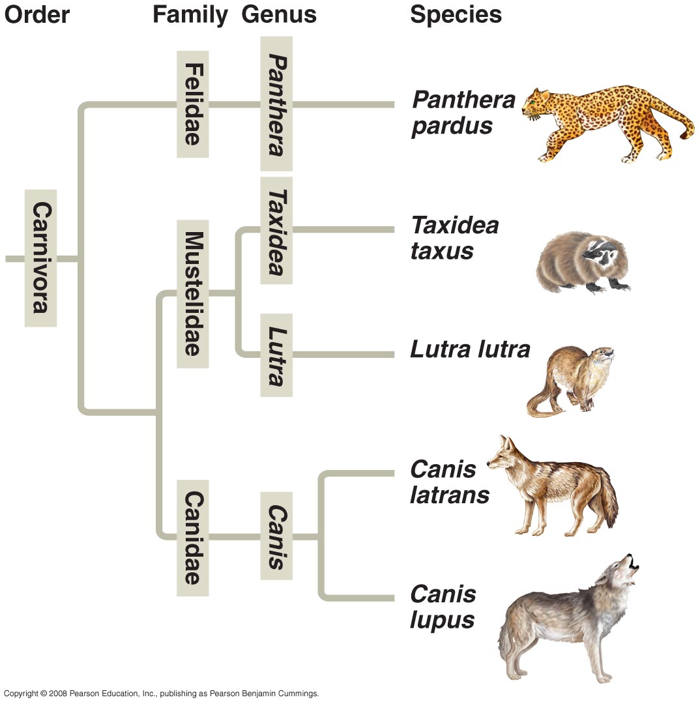
Node- represents a common ancestor

Slide 11
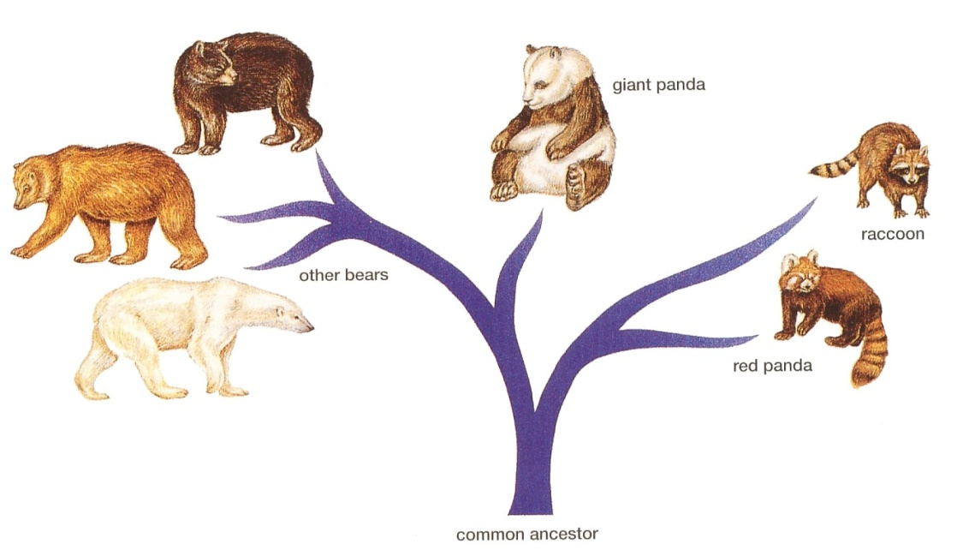
Phylogenetic Trees
the bottom of the tree represents the oldest ancestral species
the upper branches of the tree represent present-day descendant species

Slide 12
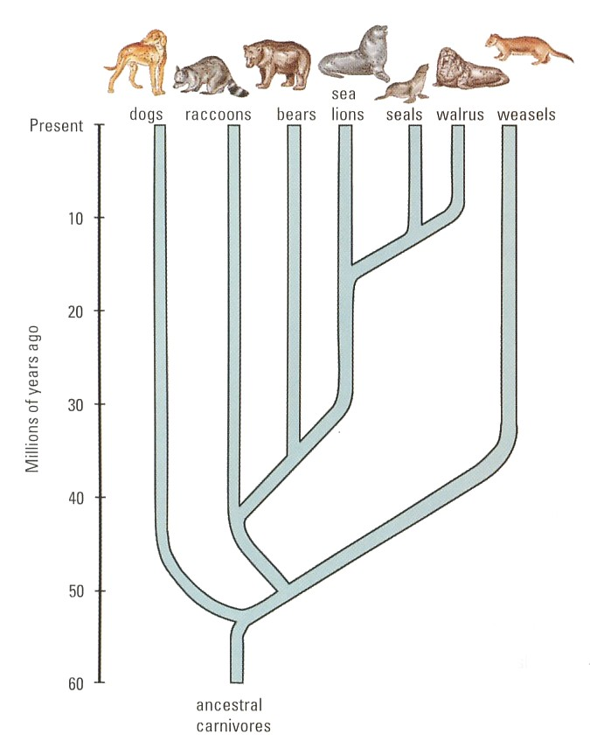

Slide 13
Dichotomous Keys

Slide 14
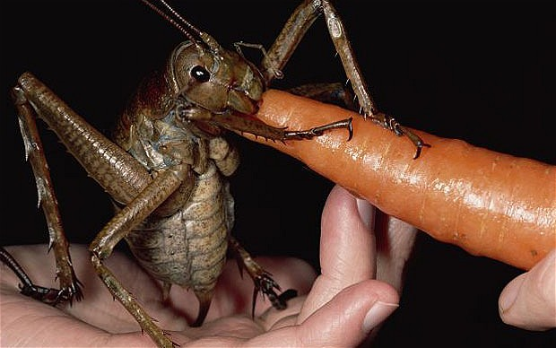
Question:
How do you identify an organism you’ve never seen before?

Slide 15
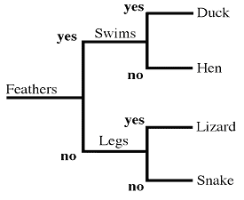
Dichotomous Keys
An identification tool used by scientists to identify unfamiliar organisms
Consists of two-part choices that lead the user to a correct identification

Slide 16
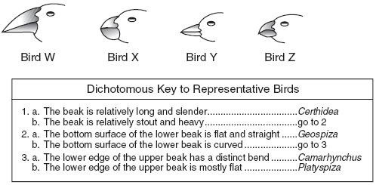

Slide 17
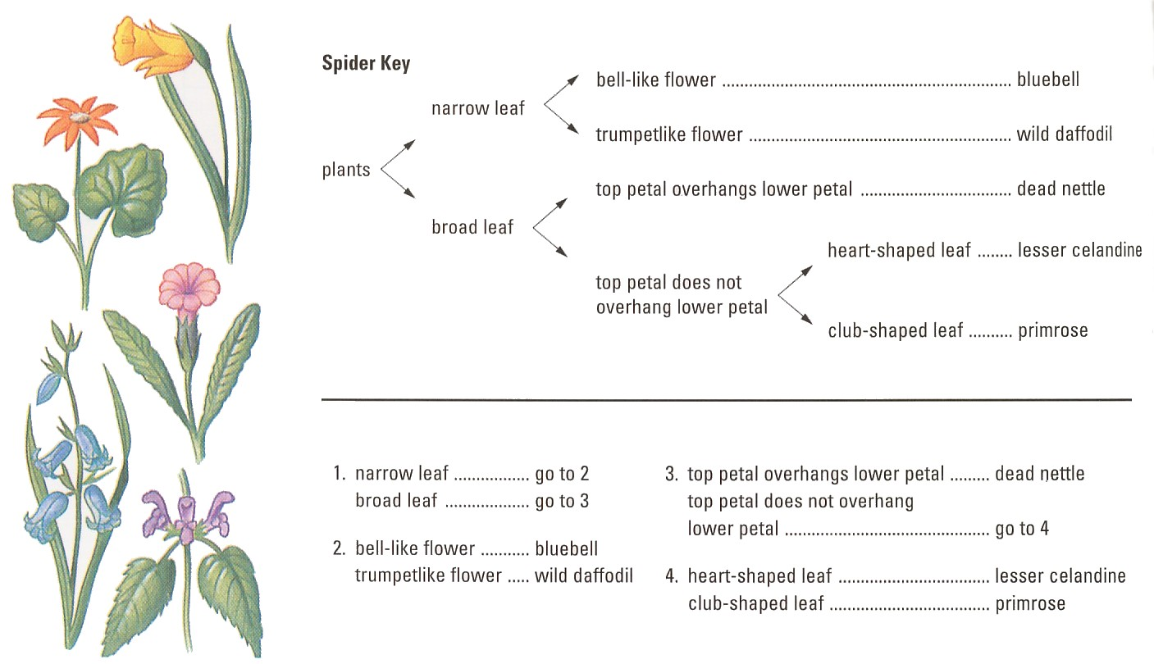

Slide 18
Using the key below, identify the following animals: Dog, Cow, Earthworm, Frog, Goldfish, Grasshopper, Horse, Robin, Snake
Animals
No hair, fur, or feathers
Has hair, fur, or feathers
No scales
Has Scales
Has hoofs
Has claws
No Legs
Has Legs
No fins
Has fins
One toe
Two toes
No wings
Has wings
Three pairs
Two pairs
A
B
C
D
E
F
G
H
I

Slide 19

A
B
C
D
E
F
G
H
I
Earthworm
Grasshopper
Frog
Snake
Goldfish
Horse
Cow
Dog
Robin

Slide 20
Practice!
Dichotomous key for selected insects

Slide 22
Group Challenge:
In groups of 10…..
Create a dichotomous key to identify EACH person in your group.

