Slide 1
Blood Vessels

Slide 2
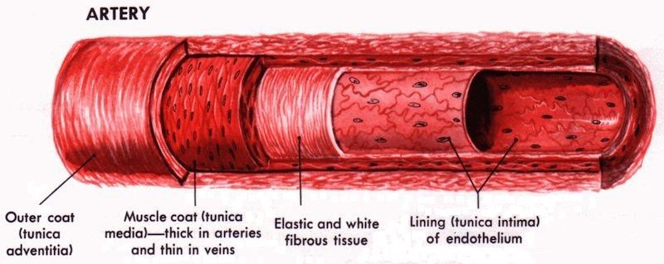
Arteries
Arteries are large blood vessels that carry blood away from the heart to cells and tissues
Arteries have thick muscular and elastic walls
High pressure, blood travels quickly in spurts (use this to measure pulse)

Slide 3
What is a Pulse?
Each contraction of heart forces blood through artery
Artery expands
This brief bulge/expansion of the artery is called a pulse
By counting the number of pulses in the artery in the wrist or neck in a 30 second interval (multiply by 2), you can determine the heart rate

Slide 4
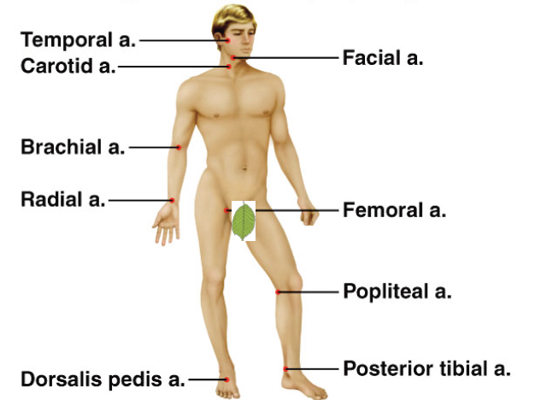
Pulse Points: where an artery runs close to the surface of the body

Slide 5
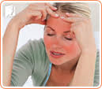
Arterioles: Controlling blood flow
Smallest arteries that branch off from arteries
Signals from nervous system regulate diameter of arterioles to control blood flow
Question: Why does your skin appear red or flushed when you are overheated?
  Blood vessels expand in diameter to bring warm blood close to surface of skin to lose thermal energy to surrounding environment

Slide 6
Blood Vessels

Slide 7
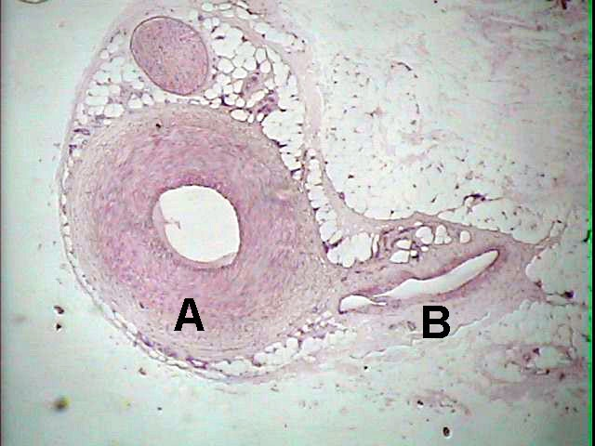
Artery Vein

Slide 8
Veins
Deoxygenated blood (carrying CO₂) returns to the heart through blood vessels called veins
The walls of veins are thinner and less muscular
Low blood pressure, blood moves very slowly
Other mechanisms to help move blood to the heart:
  gravity
  muscle contraction
  venous valves

Slide 9
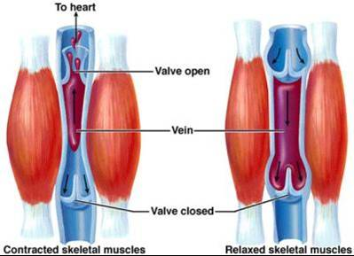
Venous valves

Slide 10
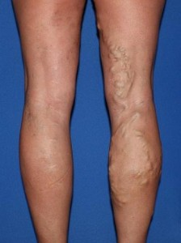
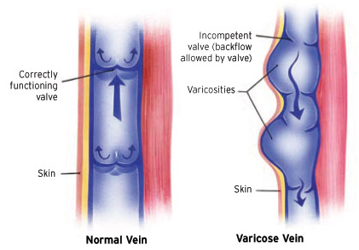
Varicose Veins

Slide 11
Blood Vessels

Slide 12
Capillaries
Capillaries are the smallest blood vessel in the body
Form networks of blood vessels that supply O2 and nutrients to EVERY cell in the body
The diameter is so small that red blood cells must travel through capillaries single file!

Slide 13
Capillaries

Slide 14
Capillaries
The capillary wall is made up of a thin, single layer of cells
Blood pressure approaches almost zero
Blood moves very slowly to allow exchange:
  Nutrients and oxygen to pass out of the blood into body cells and tissues
  Waste products and carbon dioxide to pass from body cells and tissues into the blood

Slide 15
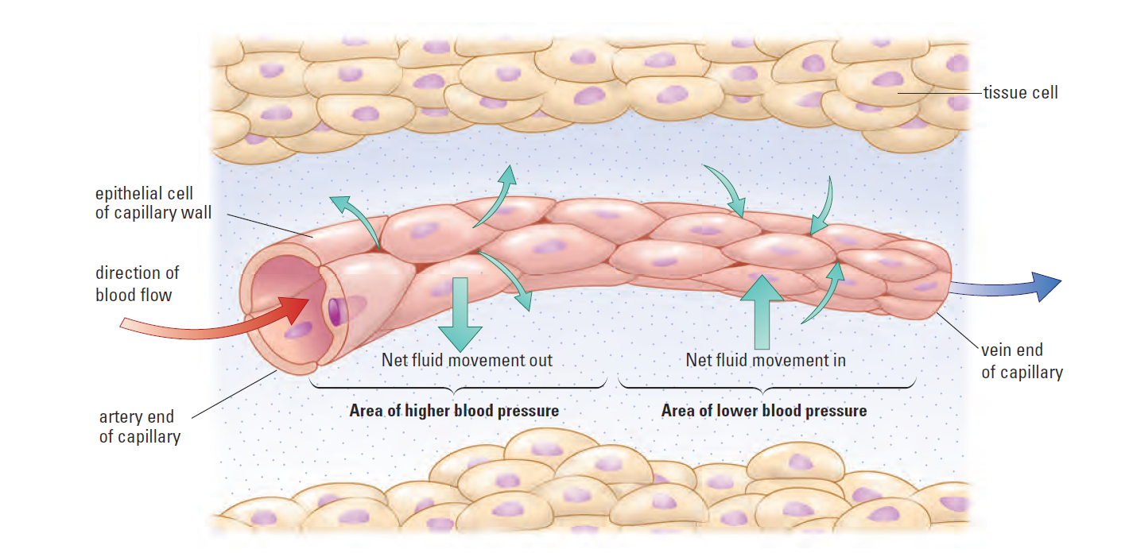
Nutrient Exchange Between Blood and Cells

Slide 16
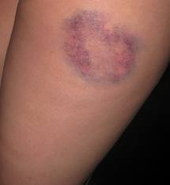
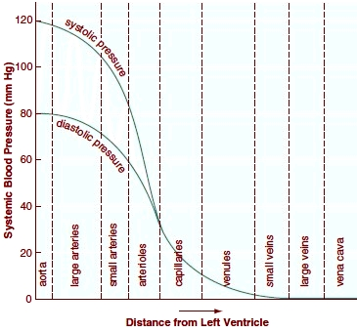
Blood Pressure
Blood exerts pressure on walls of blood vessels

Slide 17
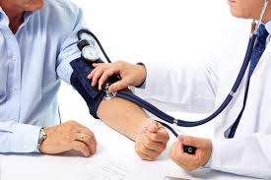
Blood Pressure
Measured with sphygmomanometer
Inflatable cuff wrapped around arm (brachial artery)
Cuff inflated until blood flow in artery is stopped
As pressure released from cuff, pressure sensors in cuff detect vibrations of blood flowing through artery
1st reading: systolic pressure (when heart contracts)
  Normal = ~120 mm Hg
2nd reading: diastolic pressure (heart is relaxed)
  Normal = ~80 mm Hg

Slide 18
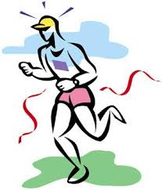
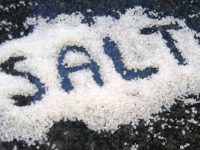
Hypertension: “The Silent Killer”
Consistently high blood pressure
Causes: medication, age, lifestyle conditions, health, diet
Dangers: forces heart to work harder to pump blood around body, ruptured blood vessels, can lead to heart attack or stroke

Slide 19
Autonomic Nervous System
The brain (autonomic nervous system) controls the diameter of blood vessels
Vasoconstriction: blood vessels contract → decrease diameter of blood vessel → reduce blood flow to tissues
Vasodilation: blood vessels relax → increase diameter of blood vessel → increase blood flow to tissues

Slide 20
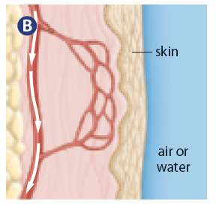
Temperature Regulation
Vasodilation
Vasoconstriction

Slide 21
Recap …
The three types of blood vessels are arteries, veins, and capillaries
Nutrients and O₂ diffuse out of capillaries and move into surrounding cells
Wastes and CO₂ diffuse out of cells into capillaries

Slide 22
Question
When a person exercises, one of the physiological responses is an increase in blood flow. In terms of the circulatory system, describe what’s happening.

Slide 23
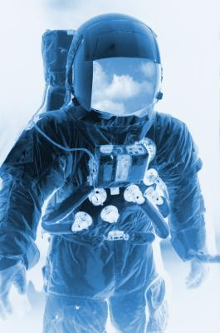
Question
How are the circulatory and musculoskeletal systems affected in space, where there is zero gravity?
http://www.livestrong.com/article/362352-the-effects-of-zero-gravity-exercise/

