Slide 1


BLOOD

Slide 2
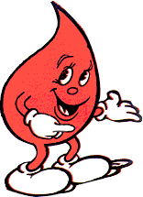
Blood
Blood is a collection of cells that have been specialized to perform a set of particular tasks
And even though it is a liquid, it is considered to be a connective tissue

Slide 3
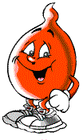
Functions of Blood
Circulates vital materials to all your cells (i.e. O2, nutrients)
Removes waste products of cell metabolism (i.e. CO2)
Equalize temperature in your body by delivering heat to the extremities
Defends your body against disease (i.e. antibodies)

Slide 4
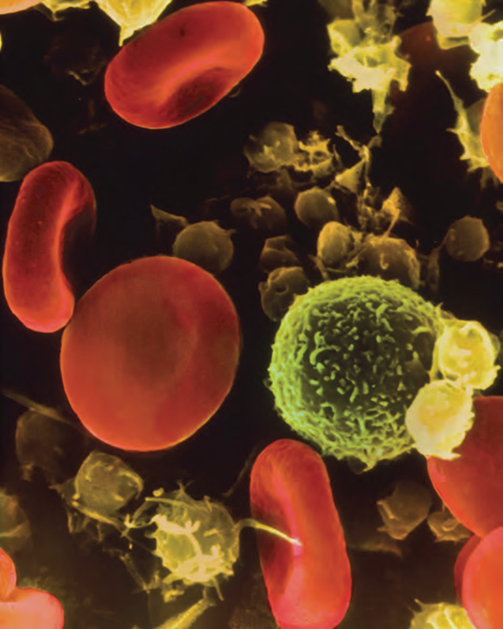
What’s in Human Blood?
Plasma (liquid)
Red Blood Cells
White Blood Cells
Platelets

Slide 5
What’s in Human Blood?
Whole blood can be separated into a liquid and cellular components
Plasma: protein-rich liquid in which blood cells, antibodies, fibrinogen, dissolved ions and platelets are suspended; 90% water

Slide 6
Erythrocytes: Red Blood Cells
Erythrocytes or red blood cells (RBCs) make up 45% of total blood volume
Bi-concave disc shape
Have no nucleus
Main function is to transport O₂ & CO₂ via hemoglobin

Slide 7
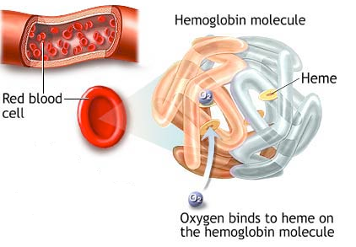
Oxygen-Carrying Capacity
is dependent on the number of RBCs that are present AND the amount of hemoglobin that each RBC contains
Each RBC is packed with 280 million iron-containing protein molecules called hemoglobin
Hemoglobin binds oxygen in a RBC
and is responsible for carrying oxygen
throughout the body
With Hg – O2 supply of 5.0 minutes;
Without Hg – O2 supply of 4-5 seconds

Slide 8
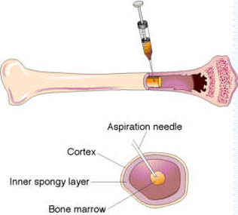
Erythrocytes
Only survive in the body for ~120 days
But RBCs do not have a nucleus, so how are they replaced?
Bone marrow!
A healthy body produces 2 million NEW RBCs every second!

Slide 9
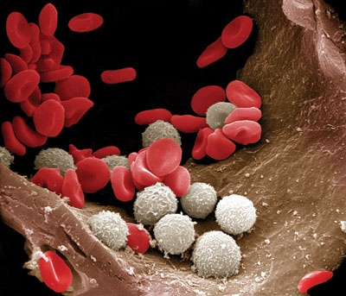
Leukocytes
Leukocytes or white blood cells make up less than 1% of total blood volume
Colourless & have nuclei
Produced in bone marrow
Numbers will double/triple when fighting infection
Defence against disease & immunity for body

Slide 10
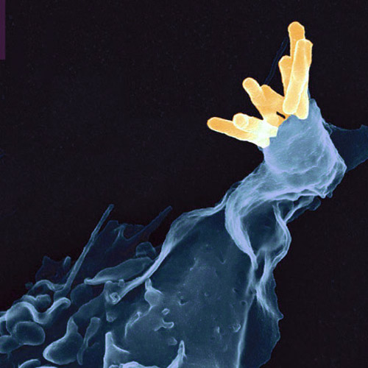
Phagocytosis
Phagocytosis (“cell-eating”) of Mycobacterium tuberculosis
http://www.youtube.com/watch?v=fpOxgAU5fFQ

Slide 11
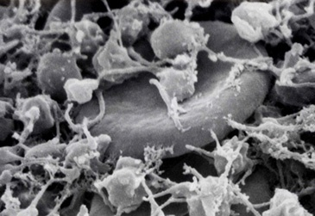
Thrombocytes: Platelets
Thrombocytes or platelets are very small irregularly shaped cell fragments
Do not contain nuclei
Breakdown quickly in blood ~ 7 to 10 days
Produced in bone marrow
Plays role in blood clotting → excessive blood loss

Slide 12
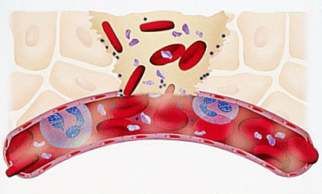
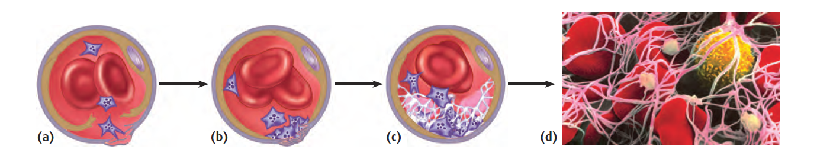
Blood Clotting
The clotting process begins when the blood vessel is damaged
Blood vessel is broken, platelets rush to site
Platelets stick to collagen fibres in blood vessel wall
More and more platelets stick to fibres, temporary clot is created to seal the hole in the blood vessel
Clotting process continues below surface as fibrinogen in the plasma is converted to long strands of fibrin forming a mesh to trap more platelets
http://www.youtube.com/watch?v=036GFPRH5-w

Slide 13
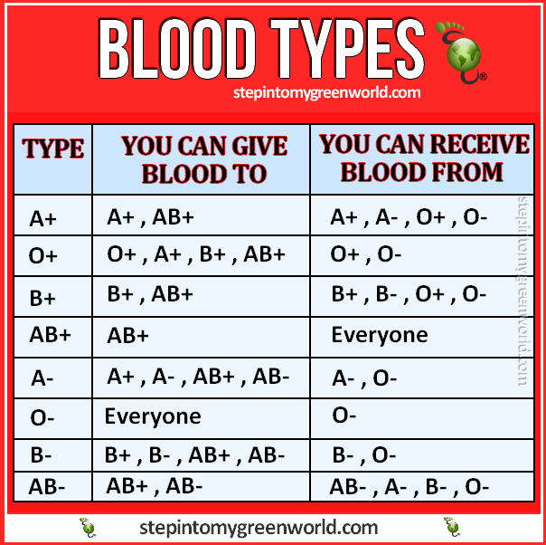
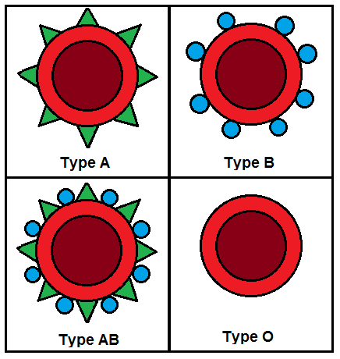
Blood Types
Each type of blood has markers (sugars) on the cell membrane of the RBC’s.
3 types: Type A , Type B , Type AB Blood https://blood.ca/en
One type cannot receive another without triggering an immune reaction. Note: universal donors and universal recipients
Additionally: Rhesus factor + or – antigen (smaller reaction)
85% of population is (+)
15% of population (-) “Rhesus negative”

Slide 14
Recap!
The three major components of the circulatory system are the heart, blood vessels, and blood
Blood is made up of red blood cells, white blood cells, platelets, & plasma
Blood transports needed materials (oxygen, nutrients) to cells and tissues and removes waste products
Circulatory System Crash Course
https://www.youtube.com/watch?v=9fxm85Fy4sQ

