Slide 1
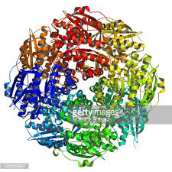
Enzymes
Protein’s Continued

Slide 2
What are Enzymes?
A living system controls its activity through enzymes.
An enzyme is a protein molecule that has 3 basic characteristics.
Increase the rate of a reaction.
Most cellular reactions occur about a million times faster than they would in the absence of an enzyme.
Enzymes act specifically with only one reactant (called a substrate) to produce products.
Enzymes can be used over and over again.

Slide 3
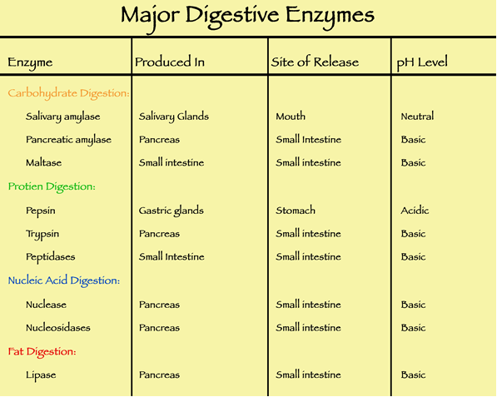
Chemically fast scissors

Slide 4
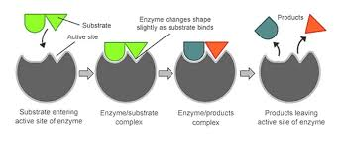
Why do we need Enzymes?
Without enzymes in your body, you could have the best nutritional plan around, and supplement your diet with a host of vitamin supplements, but without these humble workers we call enzymes, ….the vitamins will not be absorbed into your system.

Slide 5
Why do we need Enzymes?
They assist in:
fighting aging
weight loss
lowering cholesterol
cleaning the colon
breaking down fats
strengthening the immune system
improve mental capacity
detoxifying the body
building muscles from protein
eliminating carbon dioxide from the lungs etc.
Cleaning industry (stains)
Baking/winemaking

Slide 6
Key Terms
Enzyme: a type of protein catalyst found in living cells that alter the rate of chemical reactions
Catalyst: a substance that alters the rate of a chemical reaction while not undergoing a change itself

Slide 7
Key Terms
enzyme names usually end with the suffix ase or in (amylase/pepsin/lactase)
the chemical which is broken down by the enzyme is called the substrate
the new substances made are called the products
enzymes are specific to only certain substances. This is why they are referred to as a “lock and key mechanism”
enzymes can be reused and seldom wear out

Slide 8
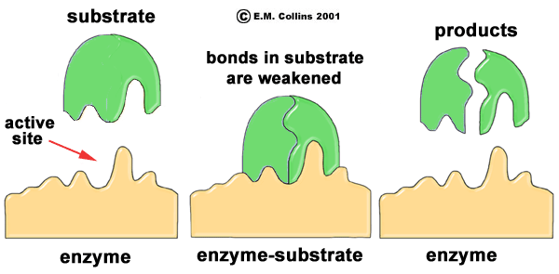
Enzymes

Slide 9
Can you control enzymes?
There are many factors that can control enzyme activity:
Temperature
pH levels (acid levels in digestive system)
Activators (stimulate enzymes)
Inhibitors (make enzymes unavailable to work)
How Enzymes Work

Slide 10
What to do now?
Describe what happens when the human body experiences lactose intolerance.
In your description, be sure to include key biological terms.
Can you extend this example to another protein that may not be working properly in the body? What is the result?

