Slide 1
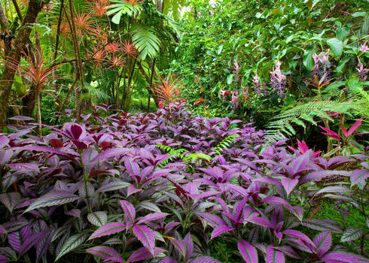
Evolution
The Theory That Explains The Vast Diversification
By: Michaela and Sumnima

Slide 2
Mutations Resulting Variation
Create new genes providing new genetic information
Influences future genes when inherited
Types of mutation
Neutral Mutations
Harmful Mutations
Beneficial Mutations

Slide 3
Beneficial Mutations
Change in individual's phenotype which supports their survival
Example- insects and other pest species have developed pest resistance to help themselves survive in today’s world

Slide 4
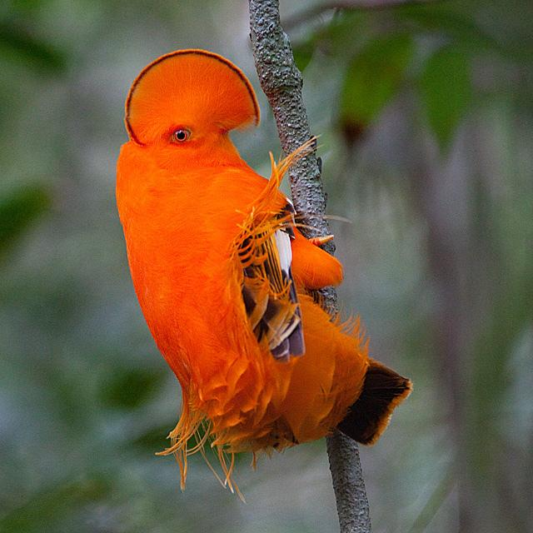
tropical bird with unique phenotype

Slide 5
Natural Selection
Nature’s way to pick the best of best:
- Species with characteristics that help them tackle the environmental factors survive
-The species who can not adapt to the changing environment become extinct

Slide 6
Artificial Selection
Human select specific trait they want to be inherited in an organism
Humans have been artificially selecting traits for dogs resulting in dogs like chihuahuas
Example, Cauliflower, Broccoli, Kale, Cabbage were all changed over time from a wild sea cabbage

Slide 7
Artificial Selection and Biodiversity
Artificial selection limits the genetic variability within the breeding population
-they reduce the overall diversity of the population
- loss of biodiversity
Don’t Mess With Nature!

