Slide 1
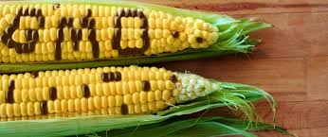
GMO or not to GMO ?

Slide 2
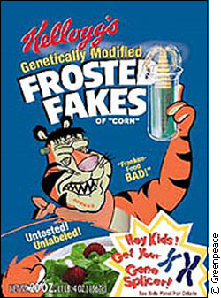

Slide 3
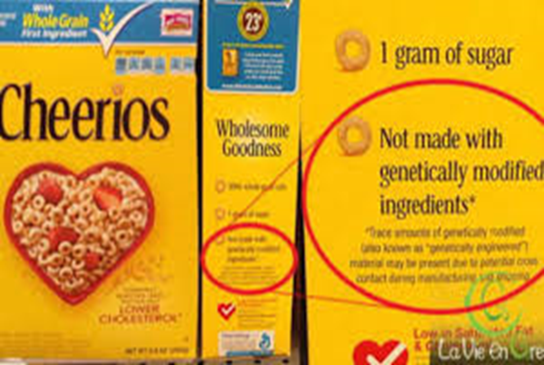

Slide 4
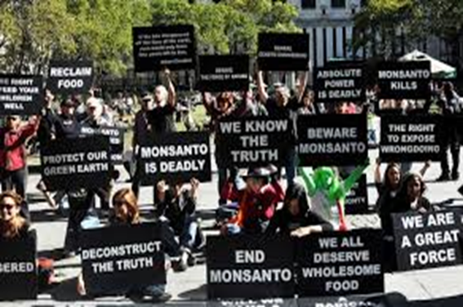
Who is Monsanto??

Slide 5
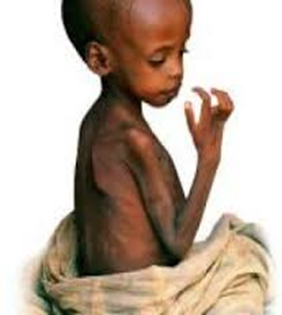
Do we not have a responsibility to improve nutrition…..

Slide 6
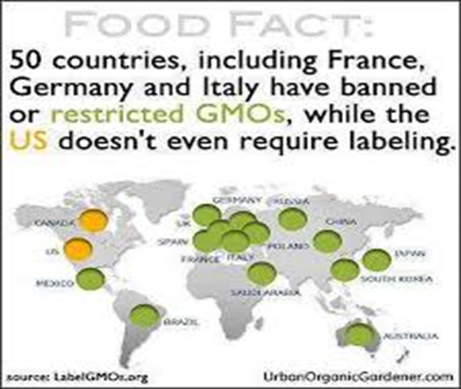
Twitter Feed: GMO in Hallowe’en Candy?
Your Guide to a Non-GMO Halloween | Living Non-GMO : The Non-GMO Project

Slide 7
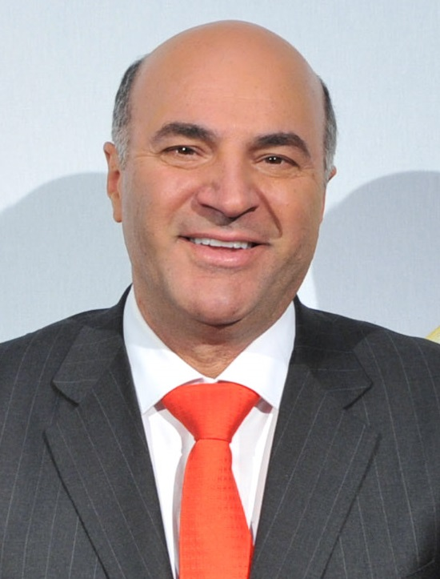
GMO - And so the debate begins….
https://www.youtube.com/watch?v=TX_-Zoom9Uc
versus

Slide 8
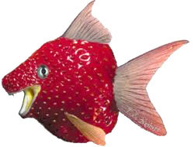
How do you feel about this Genetic Engineering?

Slide 9
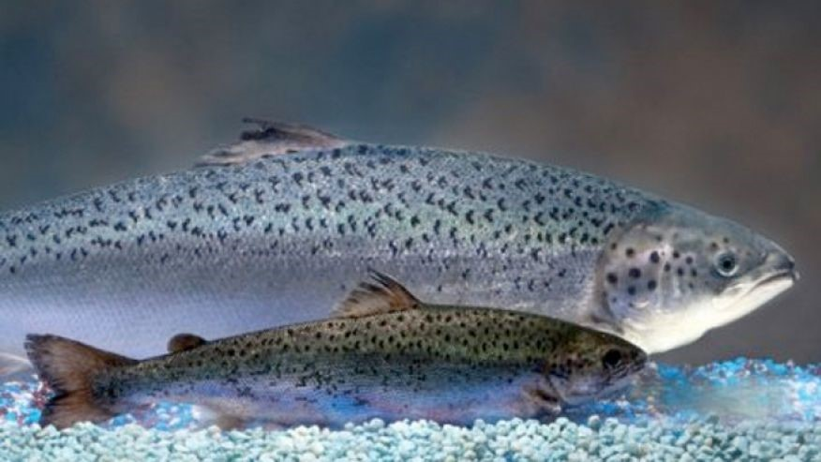
FDA Canada approved, May 2016

