Slide 1
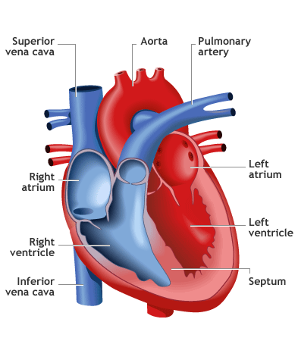
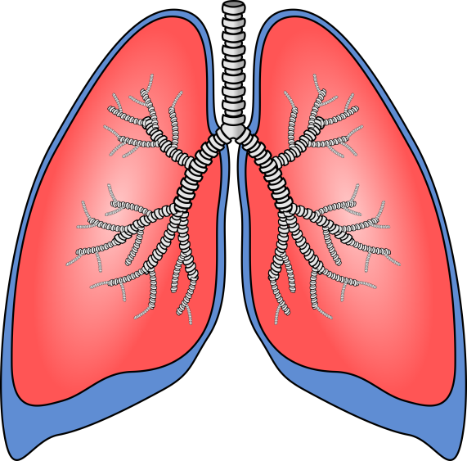
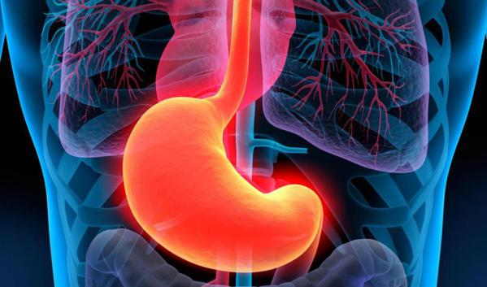
Unit #1
Animal Structure & Function
Grade 11 Biology

Slide 2
Recall - Cell Theory
  Biology as a science is based on the
  Cell Theory
All living things are made up of one or more cells.
The cell is the simplest unit that can carry out all life processes.
All cells come from other cells, they do not come from non-living matter.

Slide 3
What does it mean to be living?
To be classified as living all organisms must:
C – be made up of cells
O – be able to create offspring
W – eliminate waste
G – be able to grow
E – create / transfer energy
R – respond to their environment
L – have a lifespan

Slide 4
Internal Systems
Animals are organisms that are made up of many different types of specialized cells (structure) that perform a specific function.
Trillions of specialized animal cells work together to create tissues,
Tissues work together to work as
Organs which work together as
Organ systems which work together to keep you as an organism in homeostasis.

Slide 5
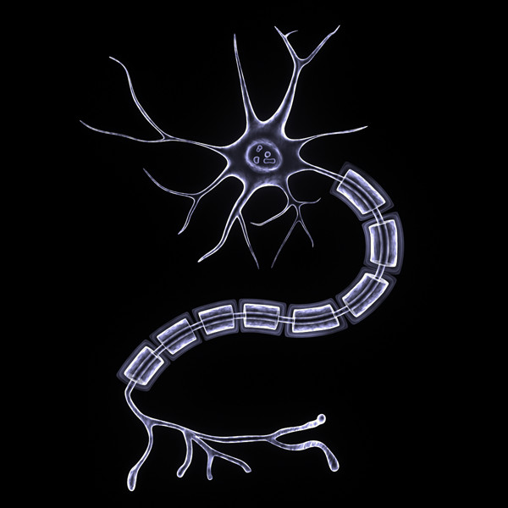
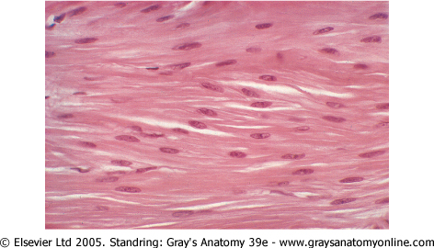
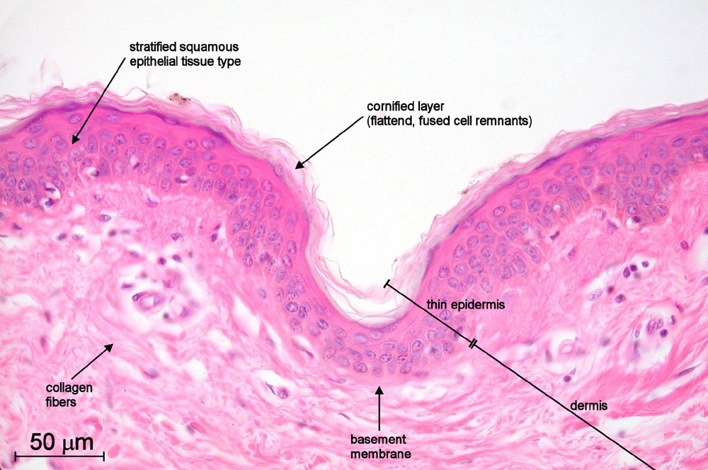
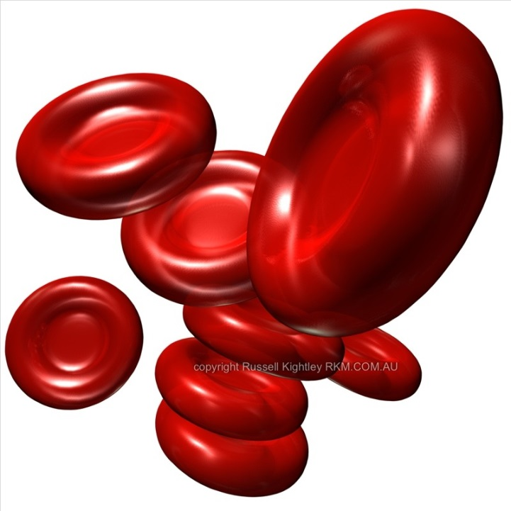

Slide 6
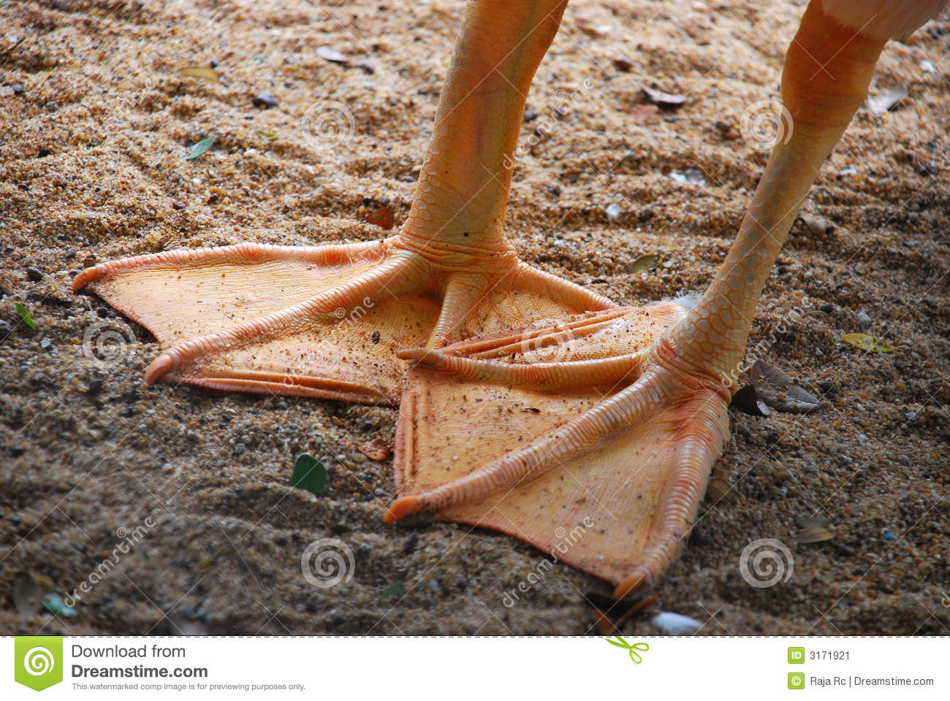
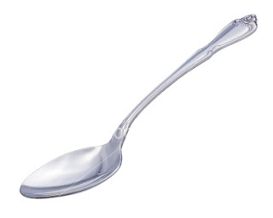


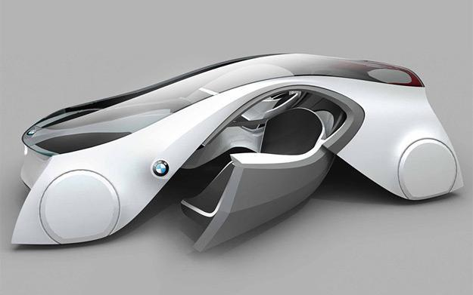

Slide 7
Key Idea
Structure always matches Function!

Slide 8
Levels of Organization in Animals
Organ system
organ
tissue
cell
organelle
molecule
atoms

Slide 9
Levels of Organization
11 Main Systems in the Body
Organ Systems that Coordinate Communication
Nervous – detects, interprets, responds
Endocrine – produces hormones (stress, devel., repro…)
Organ Systems that Acquire Energy
Digestive – breaks down nutrients
Circulatory – transports substances
Respiratory – O₂ and CO₂

Slide 10
Levels of Organization
Organ Systems that Support and Move the Body
Skeletal – bones, ligaments, cartilage
Muscular – skeletal, smooth, and cardiac muscles
Organ Systems that Protect the Body
Urinary – filters, and excretes waste (controls water, pH, and blood pressure)
Integumentary – skin, hair, nails (protection, temperature, water)
Immune and Lymphatic – infection, injury, and cancer

Slide 11
Levels of Organization
Organ System that Produces the Next Generation
Reproductive – male and female

Slide 12
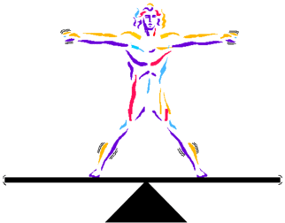
Homeostasis
Your body maintains a healthy functioning temperature of 37ºC.
The pH of your blood stays near 7.4
The amount of glucose in your blood stays near a concentration of 100 mg/mL
The ability of the body to maintain a stable, constant, balanced internal condition is called homeostasis
If a body or organ system cannot maintain this it may stop functioning, or even die.

Slide 13
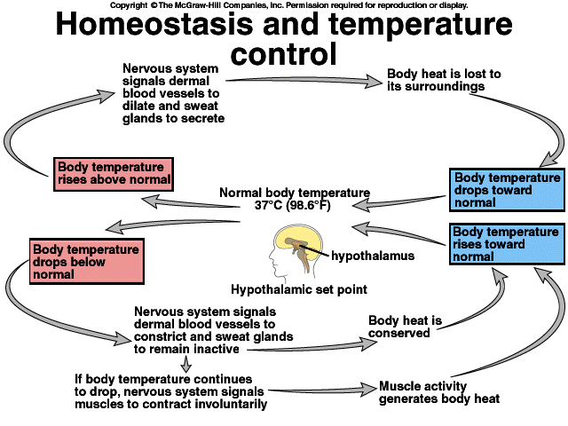
Homeostasis – negative feedback loop
Ex. Home thermostat monitors the temperature in the house.

Slide 14
Homeostasis
Homeostasis Explained the Big Bang Theory Way
https://www.youtube.com/watch?v=9RLnlXNlfdk
Practice: Questions at the end of your notes. Discuss with your neighbour one example when your body engages a negative feedback loop

