Slide 1
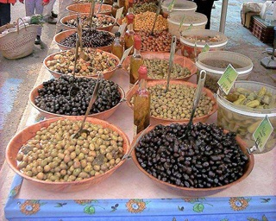
Lipids: Fats & Oils

Slide 2

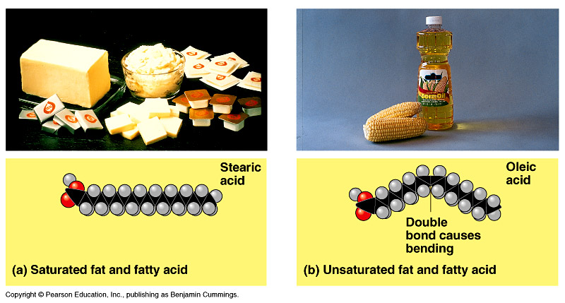
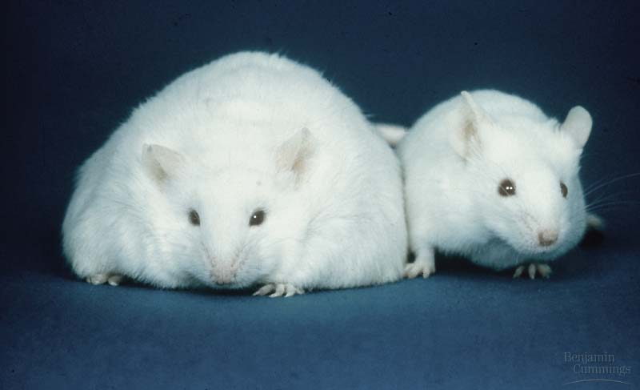
Lipids
Concentrated energy molecules

Slide 3
Lipids
A group of macromolecules that share one thing in common, they do not dissolve in water.
Lipid – Greek word for fat

Slide 4
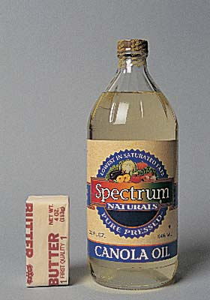
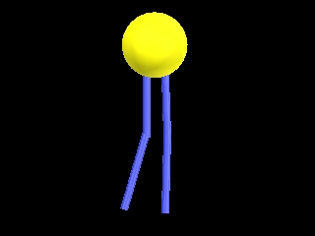
Lipids
Lipids are divided into 3 categories:
  Fats, oils, waxes
  Phospholipids
  Steroids

Slide 5
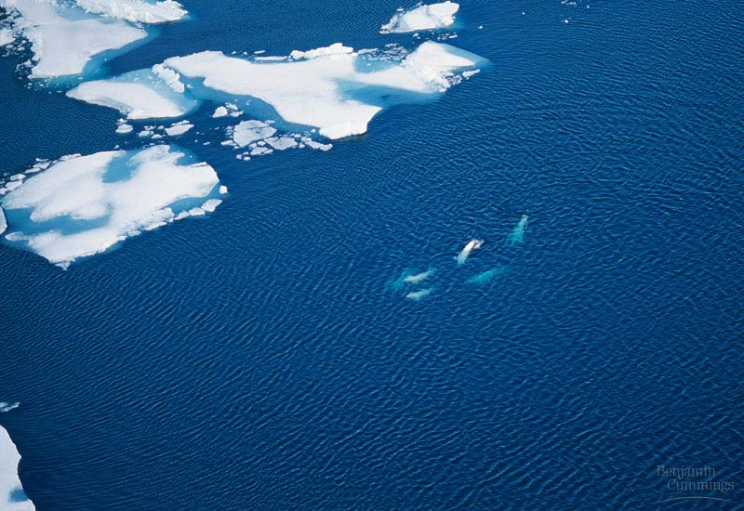
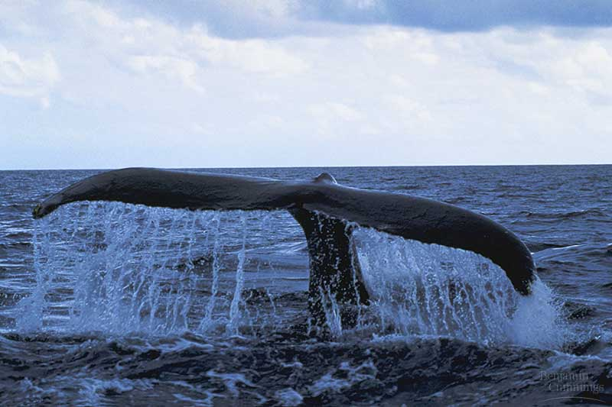
Lipids
Function:
  Long term energy storage
    very concentrated
    twice the energy as carbohydrates!
  Cell membrane formation
  Insulation and
  Cushions organs
    Think whale blubber!
  Make up hormones
    Testosterone/estrogen

Slide 6
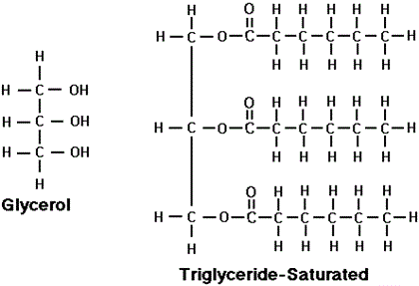
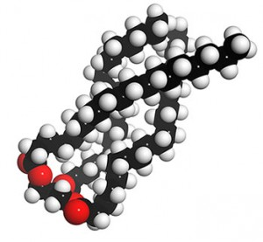
Fats/Oils
The most common of all lipids
Structure
Made up of 2 structural units which a are glycerol molecule and 3 fatty acids.
This big molecule is called a triglyceride

Slide 7
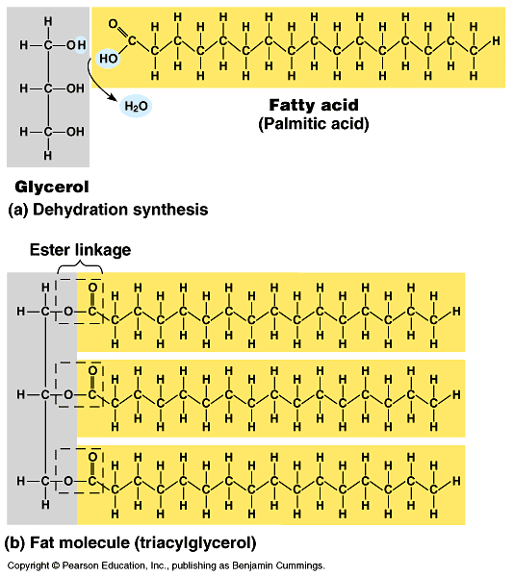
Fats/Oils
Triglycerides are made up of carbon, hydrogen, and oxygen atoms
Liquid fats are called oils
not a chain (polymer) = just a “big fat molecule”

Slide 8
Saturated Fats vs. Unsaturated Fats
Saturated Fats | Unsaturated Fats
Linear (straight) shaped molecule | Bent shaped molecule
Packed tight together | Cannot pack tight together
Solid at room temperature | Liquid at room temperature
No double bonds – therefore saturated (full) with hydrogen atoms | Have one or more double bonds – therefore unsaturated with hydrogen atoms
Come from animals | Come from plants
Difficult for body cells to break down | Easily broken down by body cells
Ex. Lard, butter, red meat | Ex. Canola, corn, olive oils

Slide 9
Saturated fats
Most animal fats
  solid at room
  temperature
Limit the amount in your diet
  contributes to heart disease
  deposits in arteries

Slide 10
Unsaturated fats
Plant, vegetable & fish fats
  liquid at room
  temperature
    the fat molecules
    don’t stack tightly
    together
Better choice in your
diet!

Slide 11
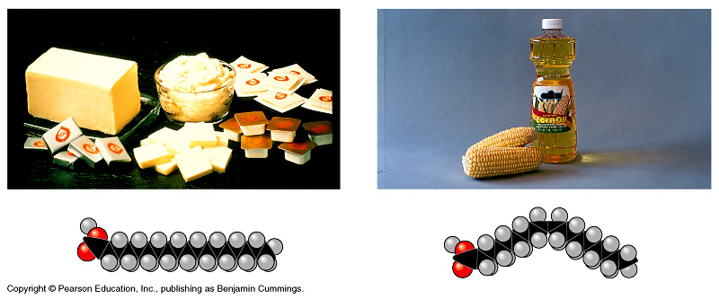
Saturated vs. unsaturated
saturated
unsaturated
✓

Slide 12
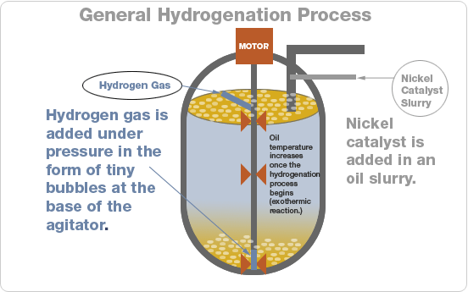
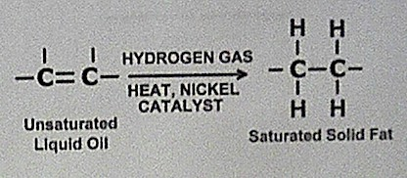
Ex. Margarine – hydrogen atoms are added to unsaturated plant fats to make them firmer in a process called hydrogenation.

Slide 13
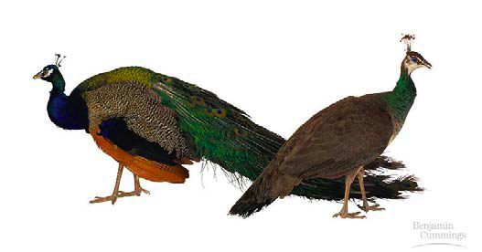
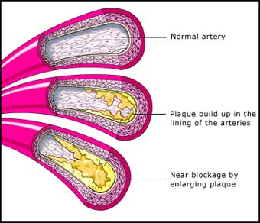
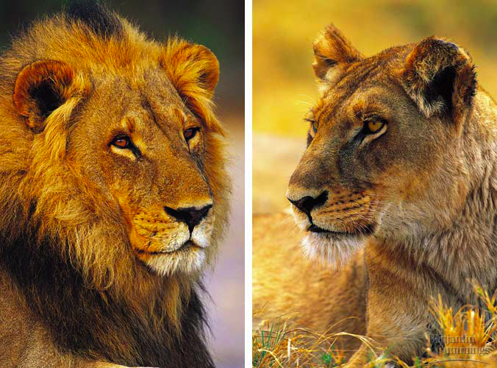
Other lipids in biology
Cholesterol
  good molecule in cell membranes
  make hormones from it
    including sex hormones
  but too much cholesterol in blood may lead to heart disease

Slide 14
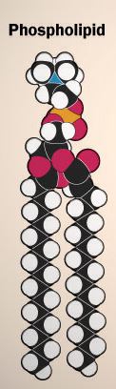
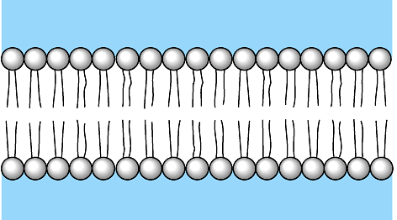
Other lipids in biology
Cell membranes are made out of lipids
  phospholipids
  heads are on the outside touching water
    “like” water
  tails are on inside away from water
    “scared” of water
  forms a barrier
  between the cell
  & the outside

Slide 15
What to do now??
Make a summary chart
 | Carbohydrates | Proteins | Lipids
Structure
Functions
Sources
Types
Unique Info?

