Slide 1
Mechanism of Inheritance
History of Genetics
Genetic Terminology
Test Crosses
Predicting Inheritance

Slide 2
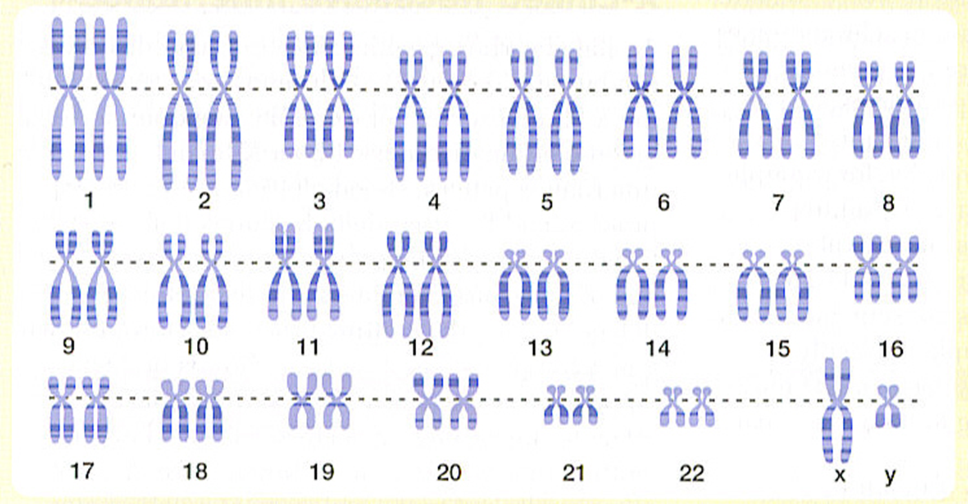
Remember…
Each chromosome in a pair codes for the same genetic trait but they provide different details.

Slide 3
Genes
Gene - A segment or band on a chromosome that determines a particular characteristic.
Each gene has different possible forms called alleles.

Slide 4
Alleles
Gene | Possible Alleles
eye colour | Brown or not brown
hair texture | curly or straight
hair colour | Light or dark

Slide 5
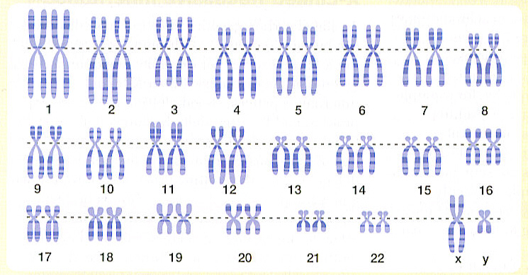
Alleles
Since we have pairs of chromosomes, we have pairs of alleles that determine a particular characteristic
Of the two alleles, one is dominant over the other.

Slide 6
Alleles
The dominant allele:
Represented by a capital letter (B)
Always represented in the physical characteristics of the individual (if present)

Slide 7
Alleles
The recessive allele:
Represented by a lower case letter (b)
Only represented in the physical characteristics of the individual if the dominant allele is absent

Slide 8
Alleles
Dominant | Recessive
brown eyes (B) | Not Brown (blue/green) eyes (b)
dark hair (D) | blonde hair (d)
Lets take a look at you!

Slide 9
There are three possible combinations for each pair of alleles
allele from parent #1 | allele from parent #2 | genetic make-up | physical appearance
B | B | BB | brown eyes
B | b | Bb | brown eyes
b | b | bb | Not brown (blue/green)

Slide 10
There are two terms used to describe the three possible combination of alleles
Homozygous (Purebred)
An individual in which both alleles are the same
homozygous dominant = BB
homozygous recessive = bb
a

Slide 11
Genotype and Phenotype
Genotype
The genetic make-up of the individual (i.e. BB, Bb, or bb).

Slide 12
Genotype and Phenotype
Phenotype
the physical appearance of the individual (i.e. brown eyes or blue eyes)

Slide 13
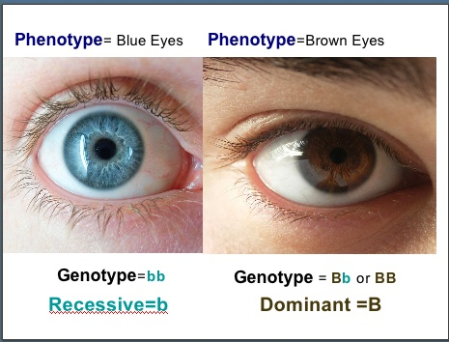

Slide 14
Human Traits
Trait | Dominant | Recessive
Eye colour | Brown or black or green | Blue or grey
Hair colour | Brown or black | Blonde or red
Hairline | Widow’s peak (pointed) | Straight across forehead
Freckles | Present | Absent
Earlobe | Suspended | Attached to head
Thumb joint | Straight thumb | Hitch-hiker thumb
Folded hands | Left thumb over right | Right thumb over left
Tongue Rolling | Rolled into U Shape | Cannot be rolled
Chin Dimple | Dimple in middle | No dimple

Slide 15
Trait | Phenotype | Dominant or Recessive | Possible Genotype
Eye colour E/e
Hair colour C/c
Hairline L/l
Freckles F/f
Earlobe B/b
Thumb joint T/t
Folded hands H/h
Tongue Rolling R/r
Chin Dimple D/d

Slide 16
What Now?
Let’s make a baby….What? The Next Generation

