Slide 1
Mechanism of Inheritance
History of Genetics
Genetic Terminology
Test Crosses
Predicting Inheritance

Slide 2
Putting a Face to DNA
https://parabon-nanolabs.com/news-events/2015/06/snapshot-nbc-nightly-news.html
Using Genotype to predict phenotype
How do your inherited genetics determine how you look?

Slide 3
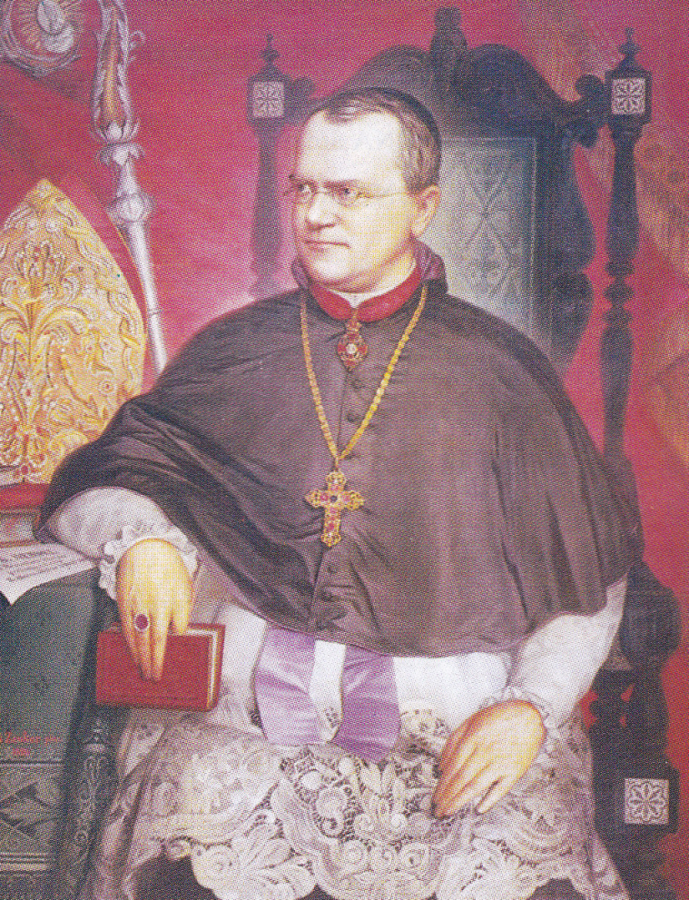
History of Genetics
Father of “modern genetics”
His work was published in 1866, but
did not become popular until 1900s.
Mendel made three major discoveries:
a. characters/traits are governed by paired
but individual “factors” (genes)
b. these “factors” may be dominant or
recessive, and
c. the “factors” combine to produce
characteristic ratios in the later generations
http://ed.ted.com/lessons/how-mendel-s-pea-plants-helped-us-understand-genetics-hortensia-jimenez-diaz#watch
Gregor Mendel
(1822-1884) – an Austrian monk

Slide 4
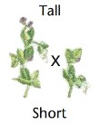
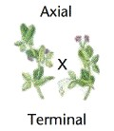
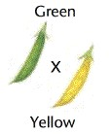
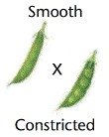
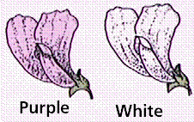
Mendel’s Genetics Model Plant
He worked with PEAS because:
They are easy to grow
crossed (mated) true breeding peas: pea plants that inherited the same traits generation after generation
Have many simple traits that distinguish strains of pea plants from each other
This includes:
→ Height - short or TALL
→ Seed colour – green or YELLOW
→ Seed shape - wrinkled or ROUND
→ Seed coat colour - white or GRAY
→ Pod shape - constricted or SMOOTH
→ Pod colour - yellow or GREEN
→ Flower position - terminal or AXIAL
→ Flower colour – white or PURPLE

Slide 5
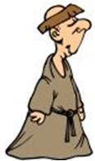
Mendel’s Genetics Model Plant
We will focus on these three (3) traits for our discussion
→ Height - short or TALL
→ Seed colour – green or YELLOW
→ Seed shape - wrinkled or ROUND
→ Seed coat colour - white or GRAY
→ Pod shape - constricted or SMOOTH
→ Pod color - yellow or GREEN
→ Flower position - terminal or AXIAL
→ Flower colour – white or PURPLE

Slide 6
Genetic Laws and Principles
Principle of Dominance
When individuals with different alleles reproduce, the offspring will only express the dominant trait.

Slide 7
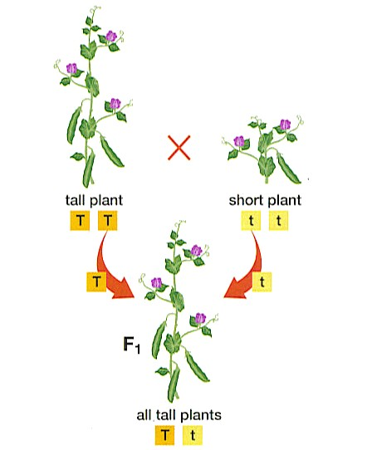

Slide 8
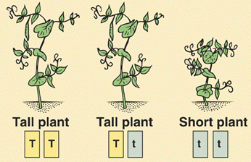
Genetics Terminology
P generation (parental)
F₁ generation (first filial): the children of P
F₂ generation (second filial): the grandchildren of the P generation

Slide 9
Predicting Inheritance
For example:
T = the gene for TALL in pea plants
t = the gene for short in pea plants
So:
TT & Tt both result in a TALL plant,
because T is dominant over t. t is recessive.
tt will result in a short plant.
Remember there are two genes for every trait! One from each parent.

Slide 10
Predicting Inheritance
Let’s cross a totally dominant tall plant (TT) with a short plant (tt).
Each plant will give only one of its’ two genes to the offspring
or F₁ generation.
TT x tt
T
T
t
t
Mendels’ “Law” of Segregation:
Each gene (allele) separates from the other so that the offspring get only one gene from each parent for a given trait.

Slide 11
Punnett Square
The genes from one parent go here.
The genes from the other parent go here.

Slide 12
Punnett Square
T
T
t
t

Slide 13
Punnett Square
T
T
t
t
t
t

Slide 14
Punnett Square
T
T
t
t
t
t
t
t

Slide 15
Punnett Square
T
T
t
T
t
T
t
t
t
t

Slide 16
Punnett Square
T
T
t
T
t
T
t
t
T
t
T
t

Slide 17
Punnett Square
T
T
t
T
t
T
t
F1: Generation
t
T
t
T
t

Slide 18
Punnett Square
The genotype for all the offspring (F1: Generation) is Tt.
The genotype ratio is:
Tt 4:4
The phenotype for all the offspring is tall.
The phenotype ratio is:
Tall 4:4

Slide 19
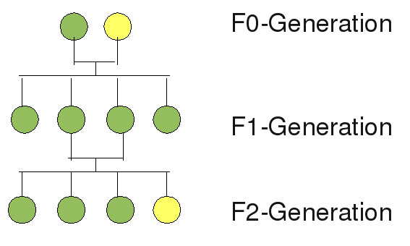
F2 Generation
When Mendel crossed green seeds from his F1 generation he saw 3 yellow:1 green seeds in his F2 generation
How can this be?

Slide 20
Try it… generation II
 | T | t
T | ?? | ??
t | ?? | ??

Slide 21
T
t
T
TT
Tt
t
Tt
tt
F₂ genotypes = 1 TT : 2 Tt : 1 tt (1:2:1 ratio)
F₂ phenotypes = 3 tall : 1 short (3:1 ratio)

Slide 22
Punnett Squares
F₂ will always have a:
Genotypic ratio of 1:2:1 1 homozygous dominant 2 heterozygous 1 homozygous recessive
Phenotypic ratio of 3:1 3 dominant 1 recessive

Slide 23
Monohybrid (1 trait) Cross
A heterozygous yellow seed pea is crossed with another heterozygous yellow seed pea. Determine the possible genotypes and phenotypes of the offspring
Let Y represent the dominant allele for yellow seed
Let y represent the recessive allele for green seed

Slide 24
Monohybrid (1 trait) Cross
In dinosaurs, the gene (T) for sharp teeth is dominant over the gene for (t) dull teeth. Cross a heterozygous sharp toothed dinosaur with a dull-toothed dinosaur to produce the F1 offspring. List the phenotype and genotype ratios.

Slide 25
Test Crosses
What if we don’t know the genotype of a dominant expression?
Mendel needed to know if the plant exhibiting a dominant trait (phenotype) was homozygous or heterozygous. So he performed test crosses.
Crossing an individual of unknown genotype with a homozygous recessive individual
→ Offspring will exhibit certain phenotypes that will allow you to determine if
unknown is homozygous or heterozygous dominant

Slide 26
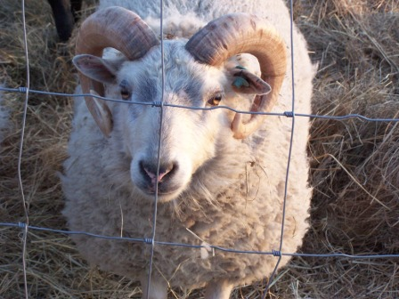
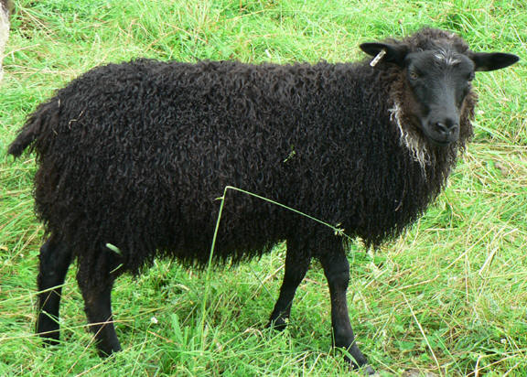
Test Crosses
Example:
A test cross is performed on a white ram whose genotype is unknown (WW or Ww) with a black ewe (ww)
Let W represent the dominant allele for white colour
Let w represent the recessive allele for black colour
X
WW or Ww
ww

Slide 27
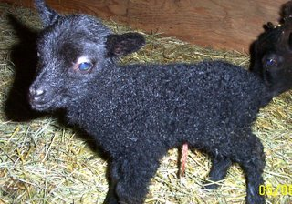
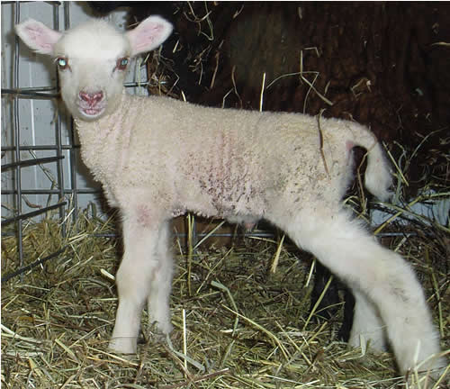
Test Crosses
If any offspring show the recessive trait, then the individual must be heterozygous
If all offspring show the dominant trait, then the individual must be homozygous

