Slide 1
The Prokaryotes
Kingdoms Eubacteria & Archaea

Slide 2
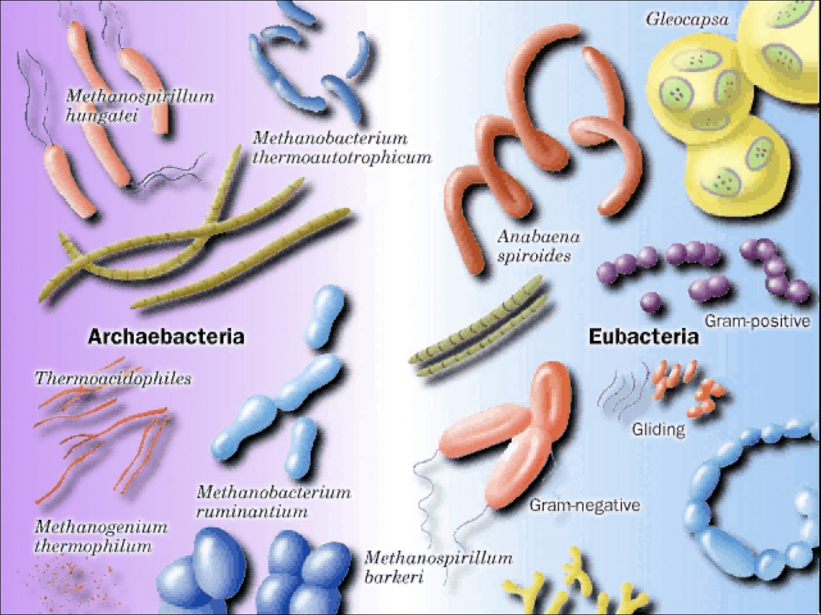

Slide 3
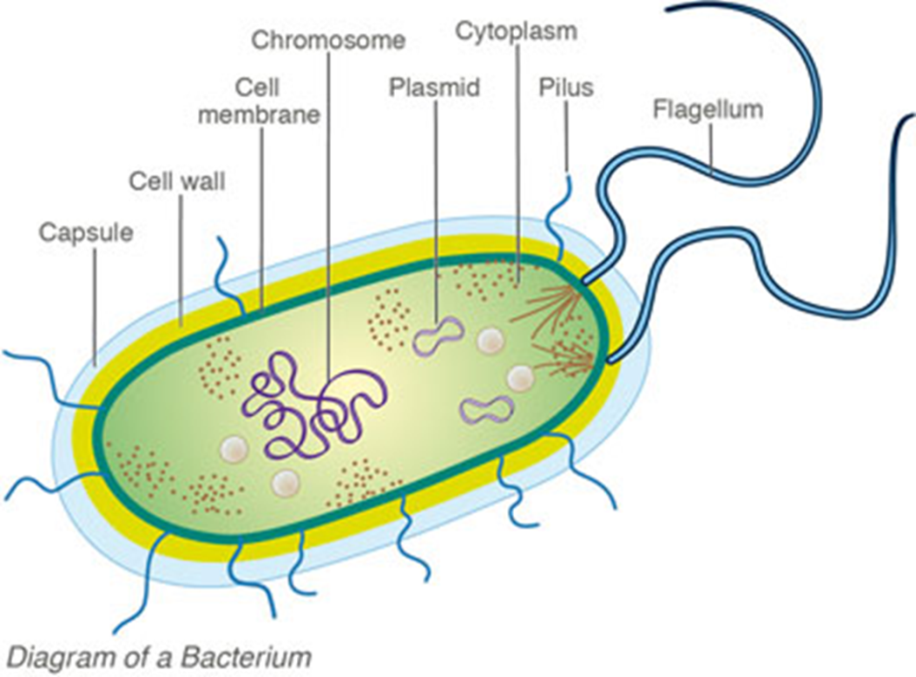
Diagram
Kingdom Bacteria | Kingdom Archaea

Slide 4
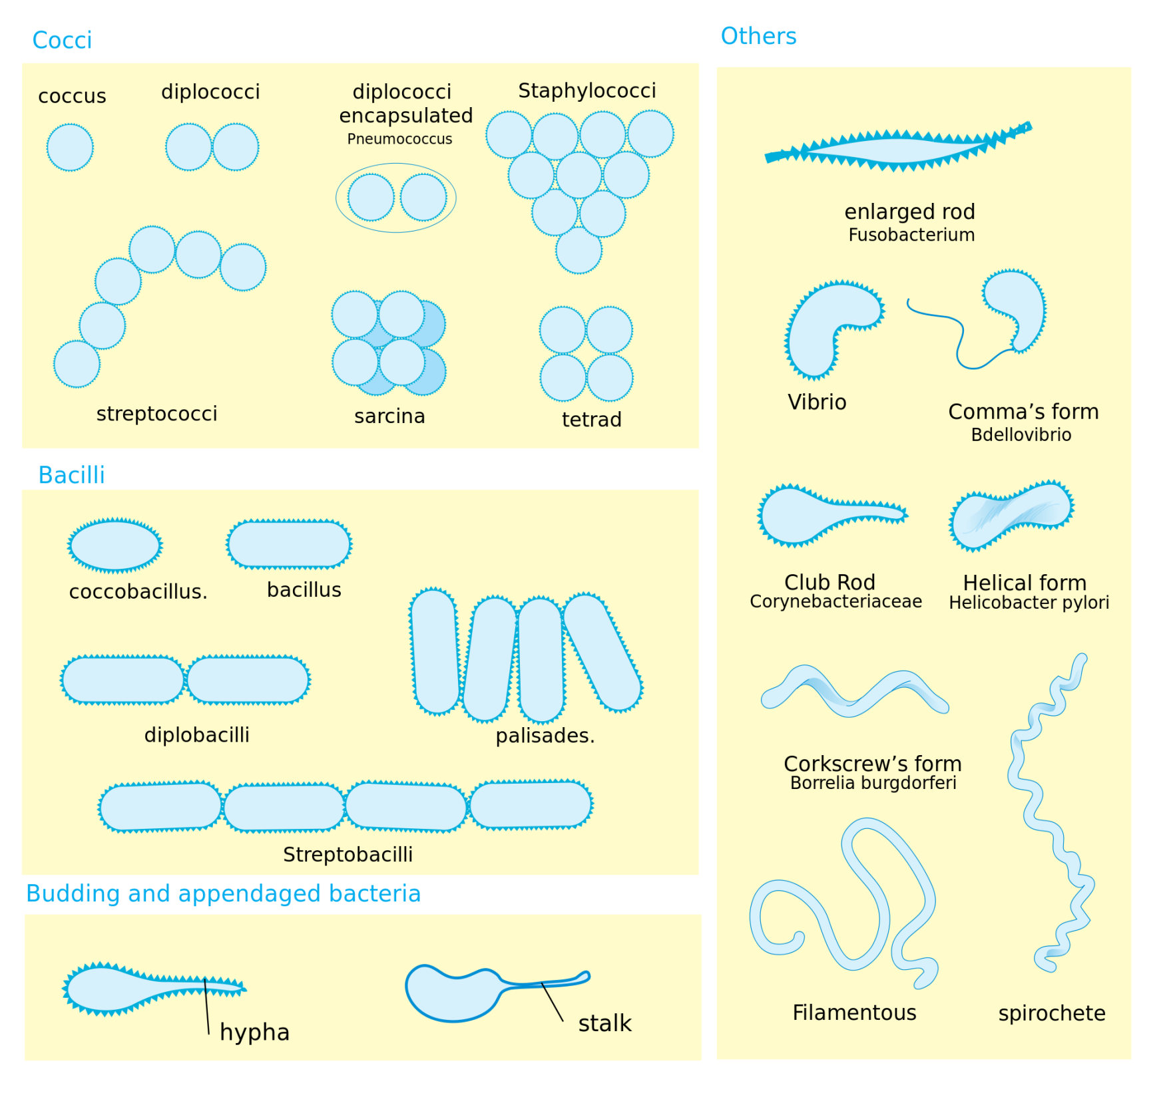
Bacteria Shapes

Slide 5
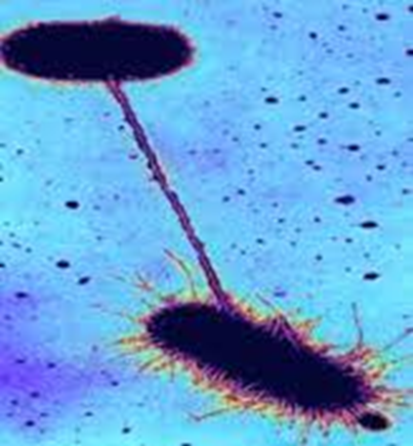
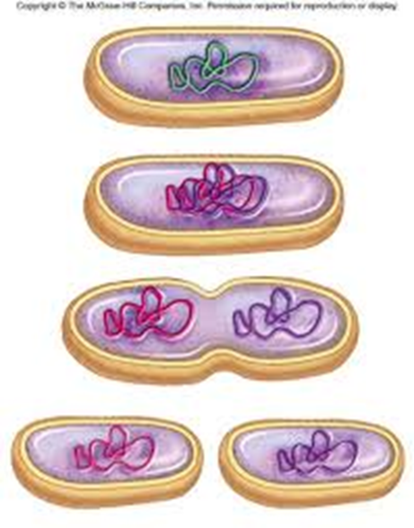
Reproduction
Kingdom Bacteria | Kingdom Archaea
- Most reproduce asexually via Binary fission (asexual) - Conjugation (sexual) | Most reproduce via Binary fission (asexual) Some reproduce via conjugation

Slide 6
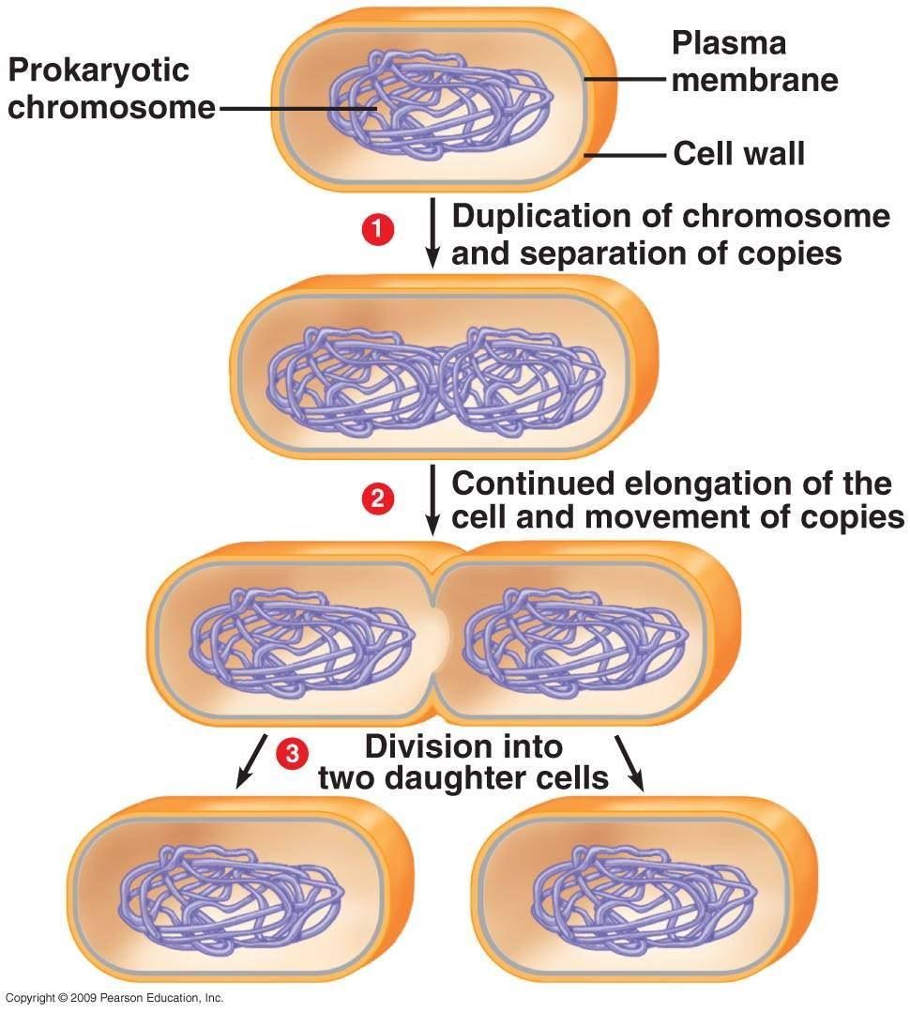
Reproduction - Binary Fission
Asexual reproduction
Cell divides into 2 identical cells
Most common form of reproduction in prokaryotes

Slide 7
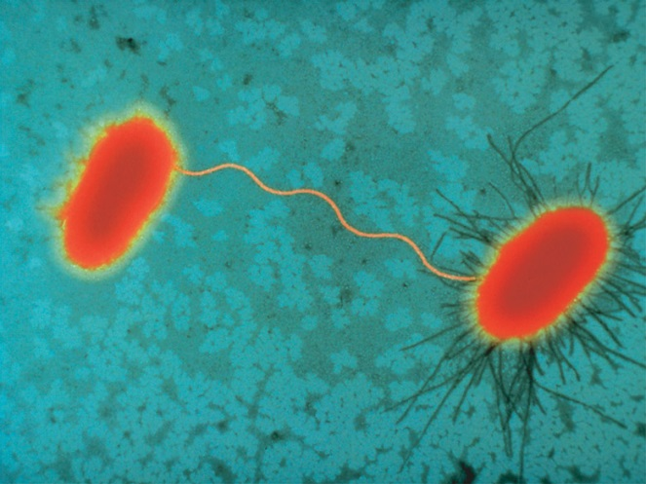
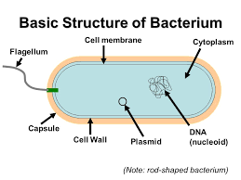
Reproduction - Conjugation
One bacterial cell passes a copy of a plasmid to a nearby hollow pilus
Exchange genetic information
Sexual reproduction
Plasmid: small loop of DNA often found in prokaryotic cells; usually contains a small number of genes
-these genes are not essential for cellular function but often provide some advantages to the cell.
EX. Genes that give bacteria resistance to antibiotics are often found on plasmids
How Bacteria Talk to Each Other: Ted Talks

Slide 8
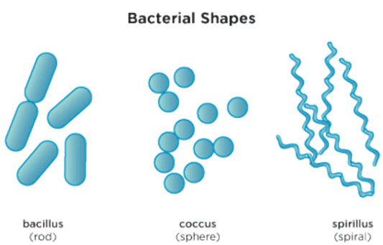
Cell Types and Characteristics
Kingdom Bacteria | Kingdom Archaea
- Prokaryotic - Cells are variable in shape and size (cocci, bacilli, spirilli) | Prokaryotic Cell membranes and walls have a unique chemical make up Cell walls and membranes are much more resistant to physical and chemical disruptions Similar shape to bacteria

Slide 9
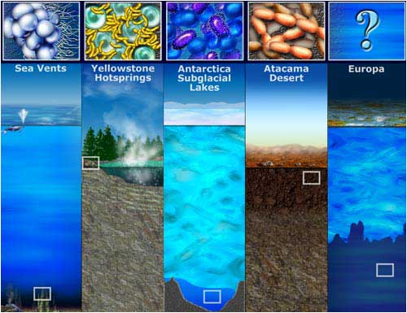
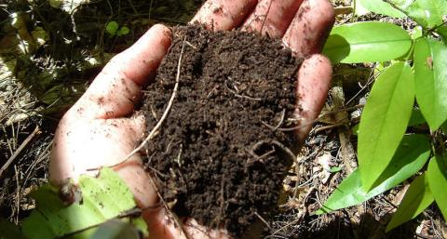
Extremophiles vs. Mesophiles

Slide 10
Nutrition
Kingdom Bacteria | Kingdom Archaea
- Photosynthesis (producers in ecosystem) - Heterotroph (decomposers in ecosystem) | Methanogenesis Those living in low-oxygen environments (swamps, marshes) Living in digestive tracts of mammals Photosynthesis Heterotroph

Slide 11
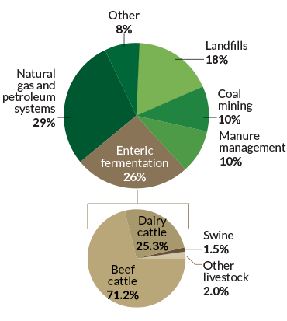
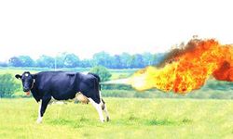
Mesophile Example
Cow Guts…
Methanogenesis: an energy making process which produces methane as a by-product.
Occurs in the digestive tract of animals or sediments of swamps.

Slide 12
Oxygen Metabolism/ Habitat
Kingdom Bacteria | Kingdom Archaea
Anaerobic and aerobic living conditions Most are mesophiles, some extremophiles Live soil, bodies, toilet bowls ect. | Anaerobic and aerobic living conditions Most are extremophiles, some mesophiles Live sediments of swamps, high salt enviros (Dead Sea), hot spring, Arctic Oceans

Slide 13
Role in Ecosystem
Kingdom Bacteria | Kingdom Archaea
They are harmful and helpful Decomposers and producers Cause infection and sickness (pathogens) | Primary source of atmospheric methane and responsible for yearly methane emissions

Slide 14
Other Facts
Kingdom Bacteria | Kingdom Archaea
Ability of bacteria to develop antibiotic resistance is a serious concern - Some bacteria produce endospores; which withstand extreme conditions for survival of that bacteria | Important but not well understood

Slide 15
Endospore
A dormant bacterial cell able to survive for long periods during extreme conditions
Ie. High temperatures, toxic chemicals
Resistant structure that forms around the chromosomes when the cell is under stress

Slide 16
Human Uses & Benefits
Kingdom Bacteria | Kingdom Archaea
Helpful bacteria lives in the digestive system and helps digest food Food industry (cheese, yogurt) | Non-pathogenic
1. Read Section 2.1 (pages 46-53) The Prokaryotes: Eubacteria and Archaea
With a partner fill out the tables for each kingdom
2. Pg. 53. Questions # 1,3,12

Slide 17
The Prokaryotes
Antibiotic Resistance

Slide 18
Bacteria and Archaea
Bad rep???
Responsible for many human deaths and diseases each year
Deaths of crops and livestock
Some bacteria play a very positive overall role on Earth
Could not survive without them
Decomposers, producers (key roles in ecosystems)

Slide 19
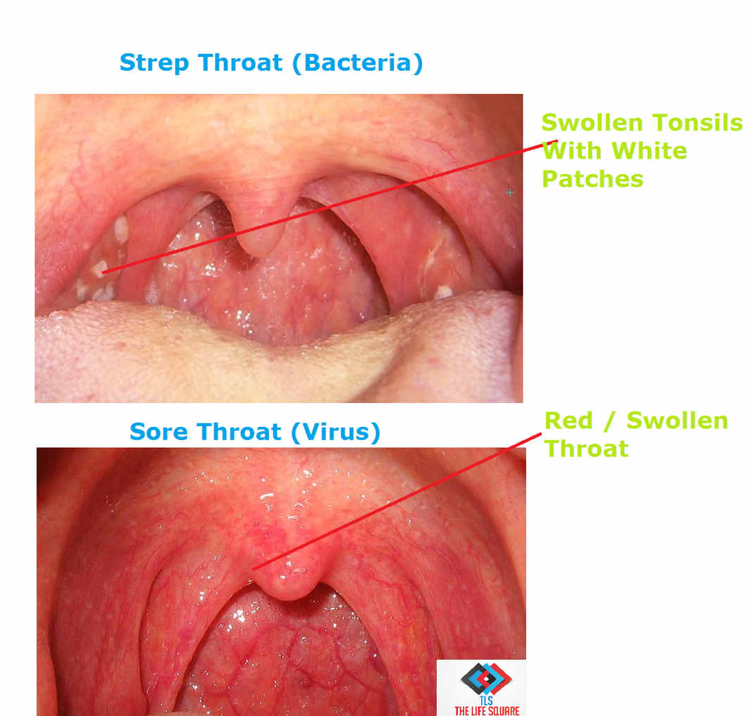
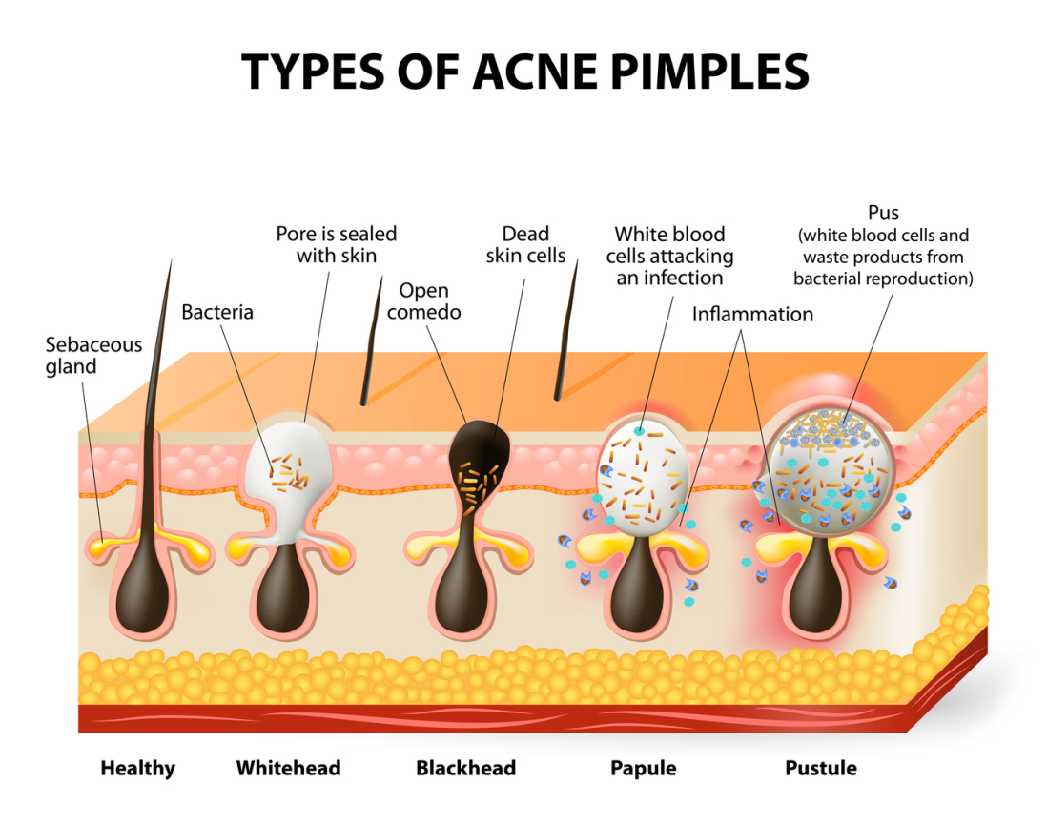
Harmful Bacteria

Slide 20
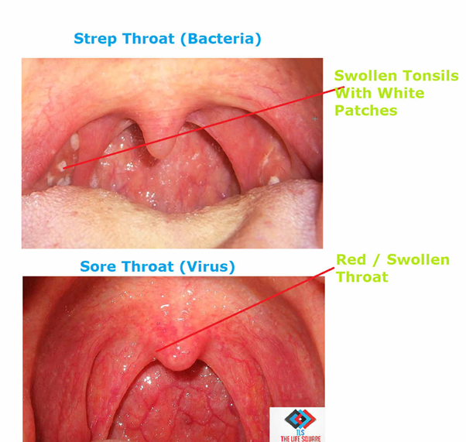
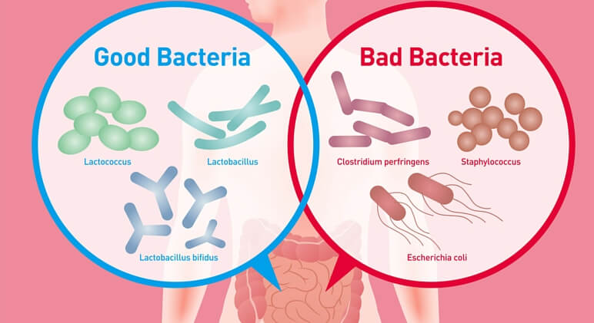
Helpful Bacteria
Probiotics

Slide 21
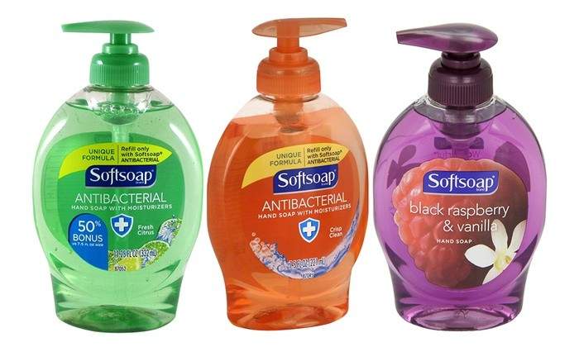
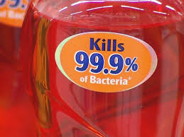
Antibacterial Soaps: More harm than good?

Slide 22
Ted Talk Questions
Why are antibiotic a miracle?
What is antibiotic resistance?
How do antibiotics protect life?
What are the factors that are contributing to antibiotic resistance?
What do we do now? What can you do?
Harmful and Helpful Bacteria Research

