Slide 1
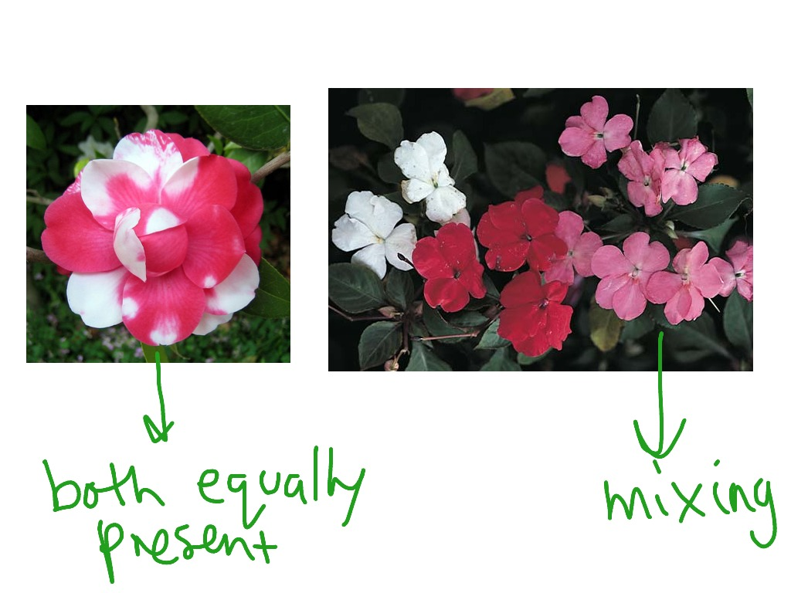
Variations in Heredity: Codominance & Incomplete Dominance

Slide 2
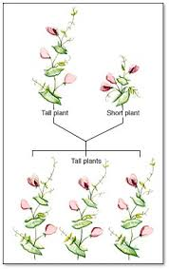
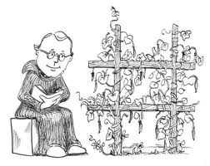
Recall Mendel….
Complete dominance:
crossing TT x tt
Only one allele expressed (dominance)

Slide 3
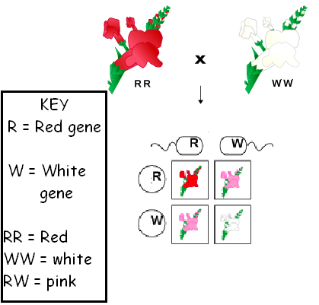
However….blended offspring
Incomplete Dominance: blending of both traits…
Snapdragons…
Let C be colour, R for Red, W for White
Heterozygous plants will be pink, as red does not extinguish white and vice versa
C^{R} x C^{W} = C^{R}C^{W (blend)}

Slide 4
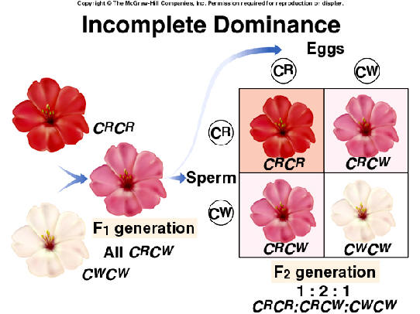
Incomplete Dominance
Note: neither allele is dominant, one cannot mask the other.

Slide 5
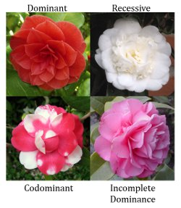
Co-Dominance…
Co Dominance: is where both alleles are expressed into a “new” phenotype
Where both dominant and recessive treats appear together

Slide 6
Blood Types are co-dominant
Blood type gene has 3 alleles
A, B or i (codes for surface markers)
Co-dominance: There are 4 possible types:
A, B, AB or O
The gene for antigen A and for antigen B are codominant
Both traits are expressed completely when gene A is inherited from one parent and gene B is inherited from the other parent

Slide 7
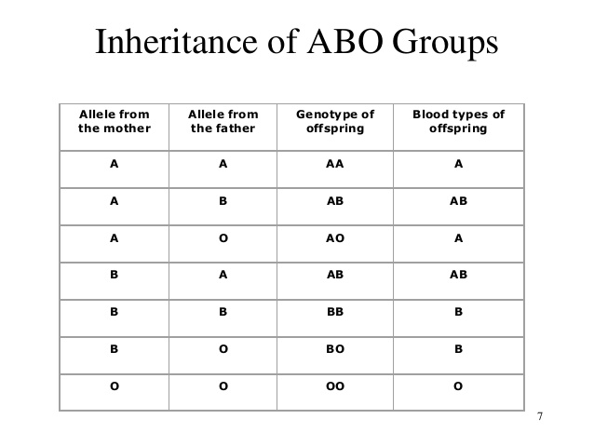

Slide 8
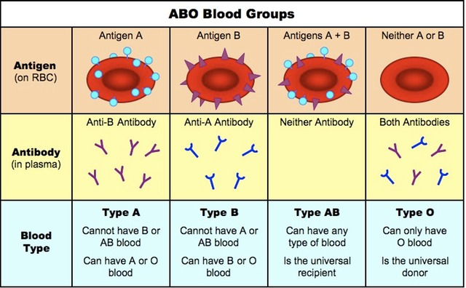
ABO Blood Types Compatibility

Slide 10
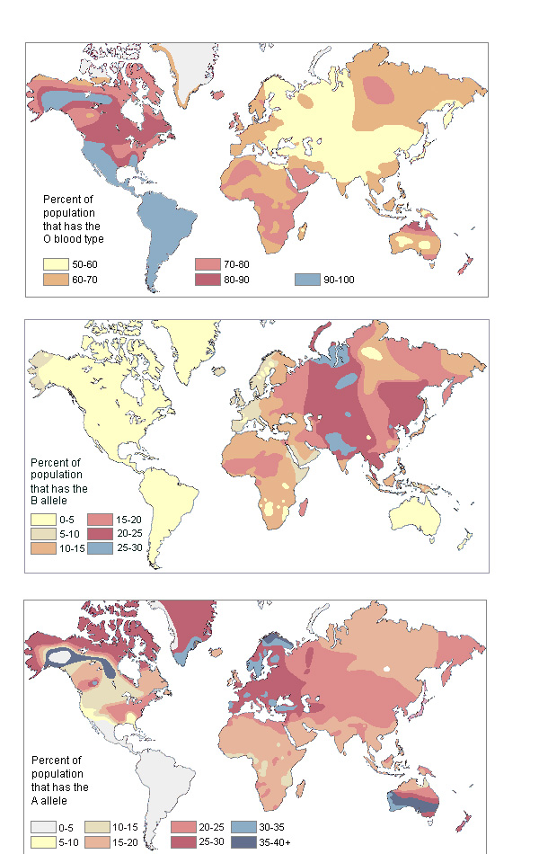
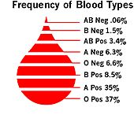
Frequency of Blood Types

Slide 11
Practice…
On page 195 of your text:
read and answer the following questions:
Snap Dragons: Show F1 and F2 generations from red and white flower cross, 4x4 punnett square.
Blood Types…
1) List the 3 blood type alleles?
2) List the 4 blood types and give their genotypes
3) Which blood types demonstrate dominant and codominate traits?
Prepare for CSI Case….

