Slide 1
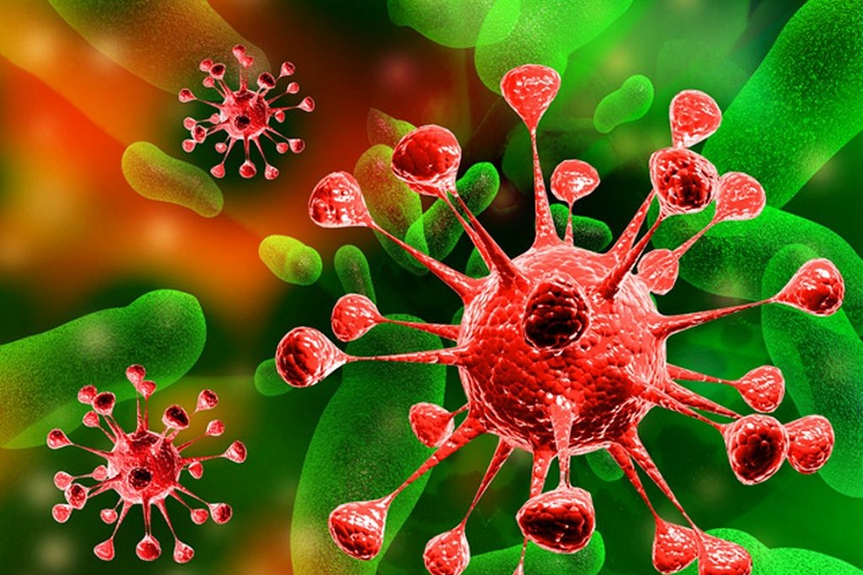
Viruses 1 – harmful or helpful?

Slide 2
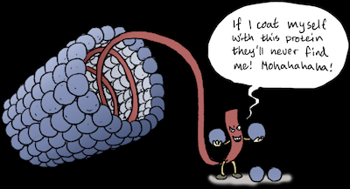
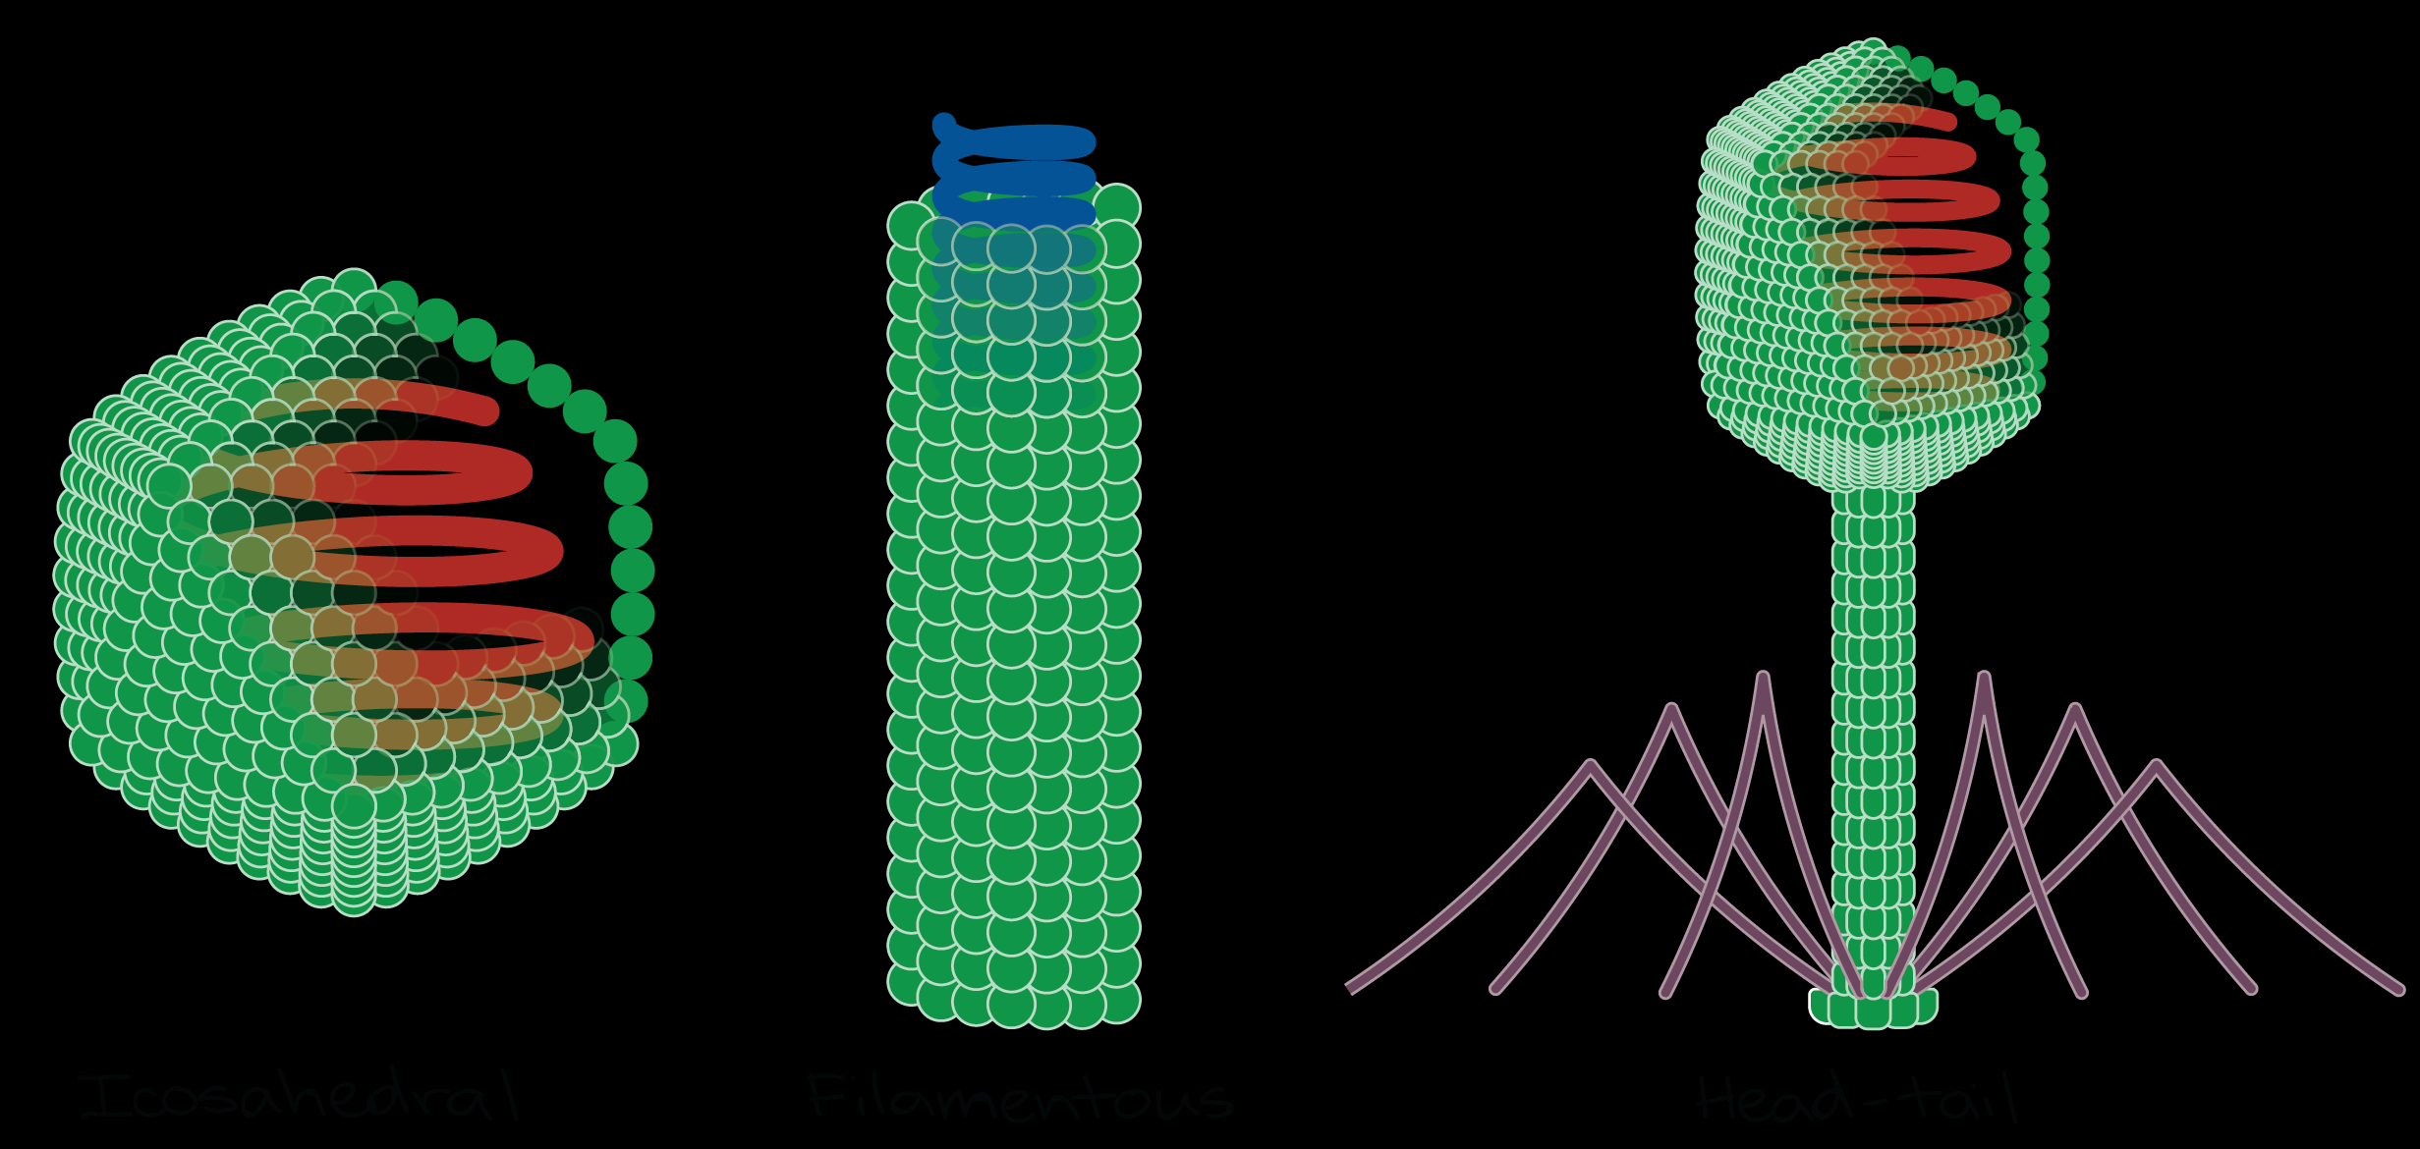
Virus Definition
A non-cellular, lifeless particle
Not classified in any of the Kingdoms
Recall characteristics of living things - COWGERL
Consists of genetic material (DNA or RNA) surrounded by a capsid (made of protein)

Slide 3
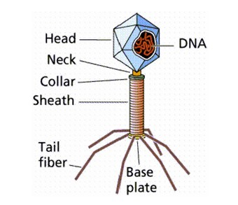
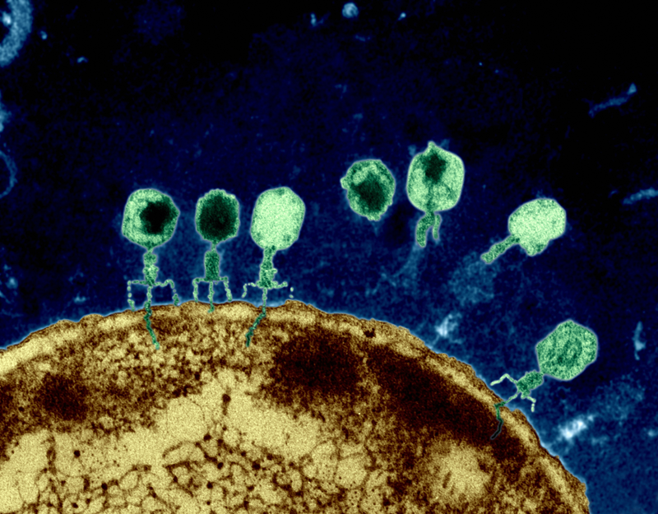
Virus Definition
Requires a host in order to replicate
Can not make it’s own energy
There are 165 groups of viruses
Bacteriophages ( 1 of the 165 groups) is the most understood
This virus attacks bacteria

Slide 4
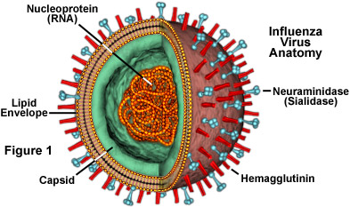
Virus Description
Viruses are made up of 2 parts:
Genetic material which is DNA or RNA
Capsid which is a protective protein coat
Viruses range in size from 10-400 nm
Foot and mouth virus…..10 nm
Influenza virus……… 115 nm
Small pox virus ……….250 nm

Slide 5
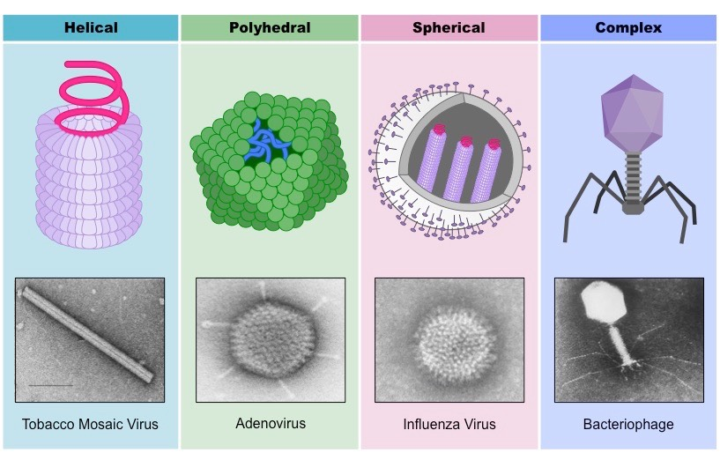
Types and Shapes of Viruses

Slide 6
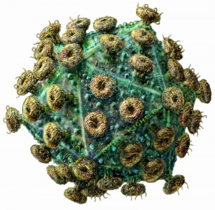
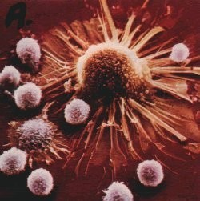
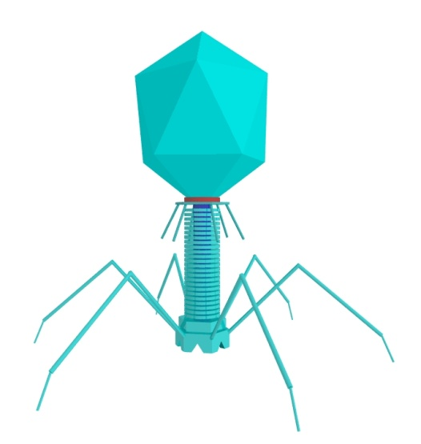
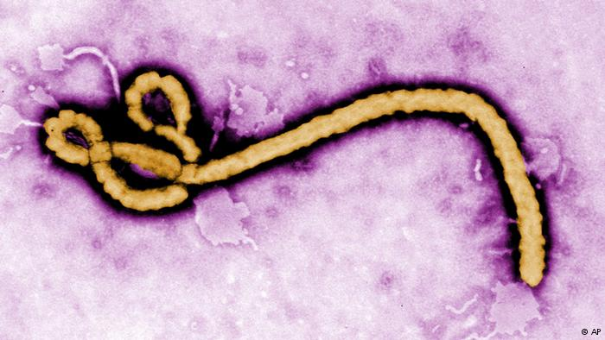
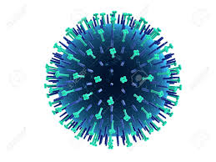
Cold Virus
HIV
Ebola
H1N1

Slide 7
Why are viruses important?
Population control of other organisms
Responsible for many human diseases
Epidemic: Outbreak in a limited geographic region (ex. Ebola in Africa)
Pandemic: Global or large-scale outbreak (ex. AIDS around the world)
Plays a role in certain cancers
Grey’s Anatomy - Bubble Boy Disease
https://www.youtube.com/watch?v=tT51LDO9lo4

Slide 8
Discovery: Group Work
Group 1: Common Cold
Group 2: HIV
Group 3: Ebola
Group 4: Chicken Pox
Group 5: H1N1
In your notes, research the following:
Draw your virus (structure)
Function (how does your virus work)
Transmission?
Cure/Treatments?
Uses – biotechnology, can your virus be helpful?

Slide 9
Ted Talks
The jungle search for viruses
https://www.ted.com/talks/nathan_wolfe_hunts_for_the_next_aids

