Slide 1
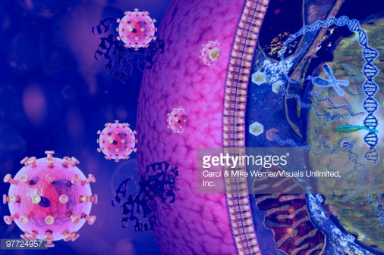
Viruses 2

Slide 2
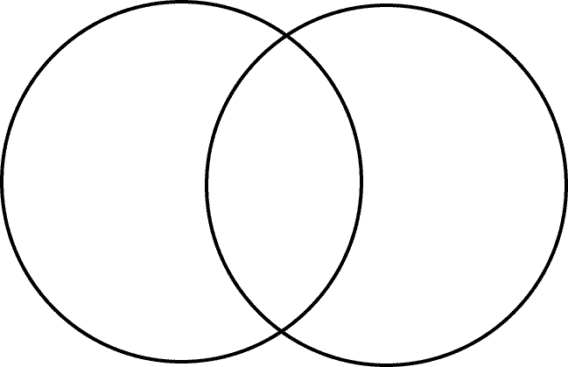
Lytic Cycle Only
Lysogenic Cycle Only
Both Cycles

Slide 3
Viral Reproduction
Lytic Cycle
Virus attaches to cell
Injects DNA or RNA into cell
Host cell replicates (makes copies) of DNA or RNA
New virus particles are assembled
Host cell breaks open and releases new virus particles
Virus particles able to attack another healthy cell

Slide 4
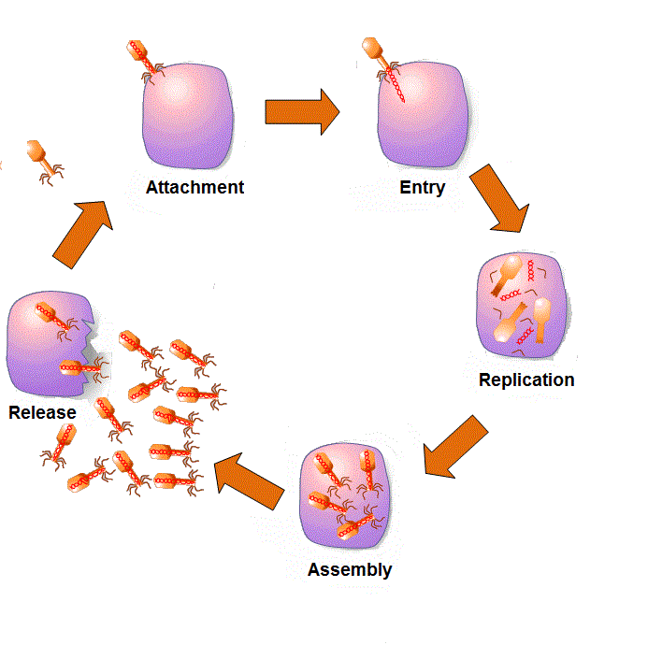
Lytic Cycle

Slide 5
Viral Reproduction
Lysogenic Cycle
Virus injects DNA into cell
DNA is incorporated into cell’s DNA
Viral DNA can stay in a dormant state for many years
As cell goes through mitotic divisions, all following cells contain viral genes
Something triggers (pH, temperature, stress) the viral DNA to separate and then the lytic cycle starts
https://www.youtube.com/watch?v=Rpj0emEGShQ - Flu Attack

Slide 6
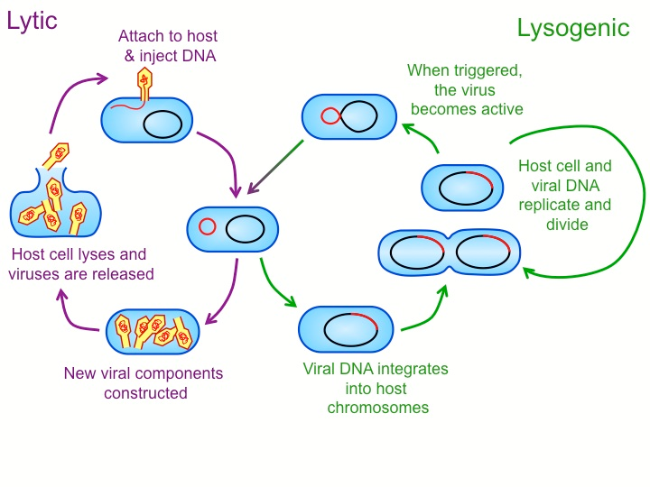
Lysogenic Cycle

Slide 7
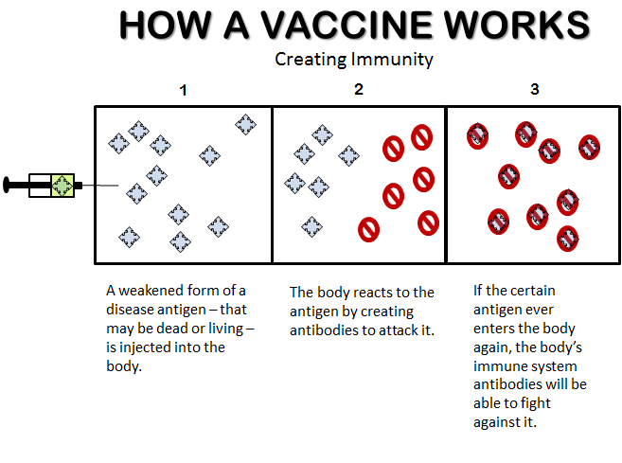

Slide 8
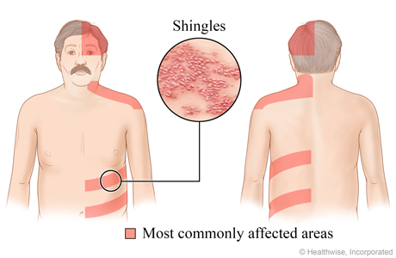
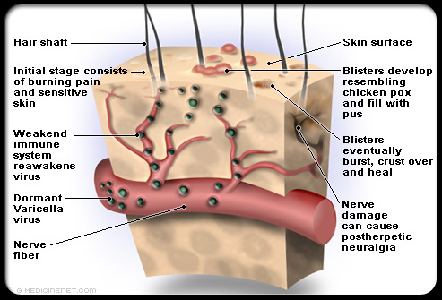
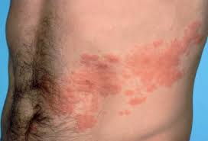
Shingles
- varicella-zoster virus

Slide 9
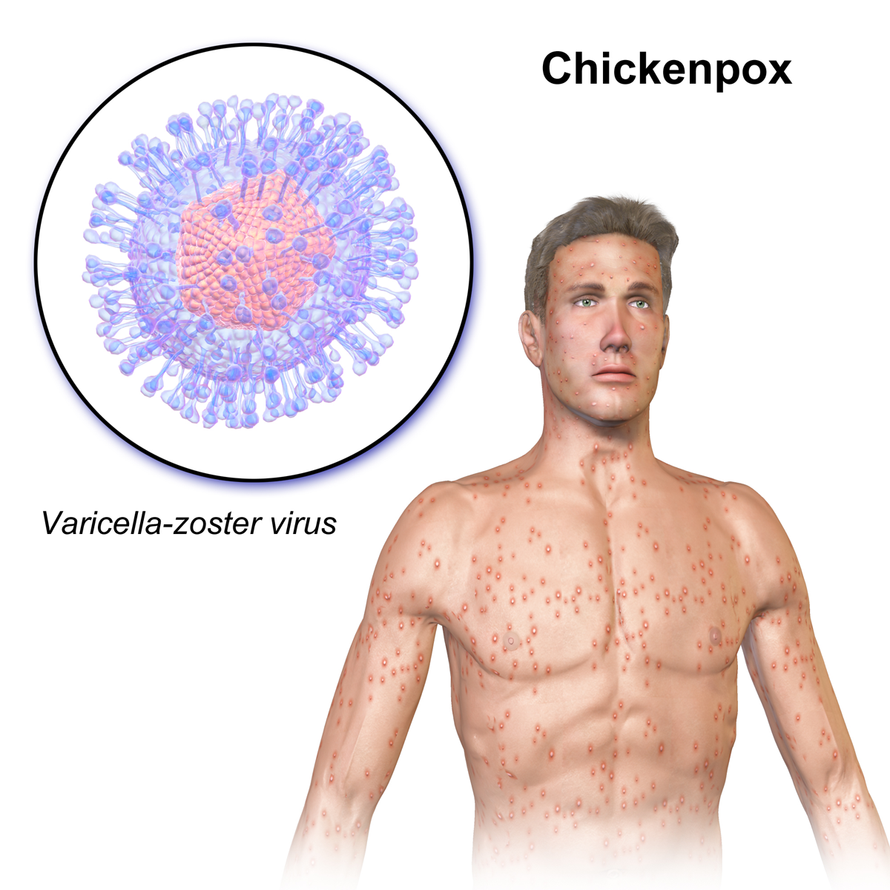
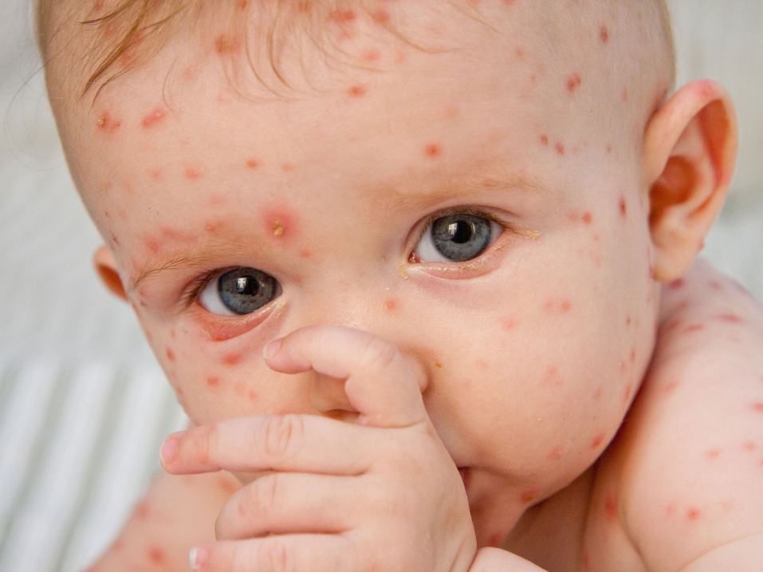
Chicken pox

